Slide 1
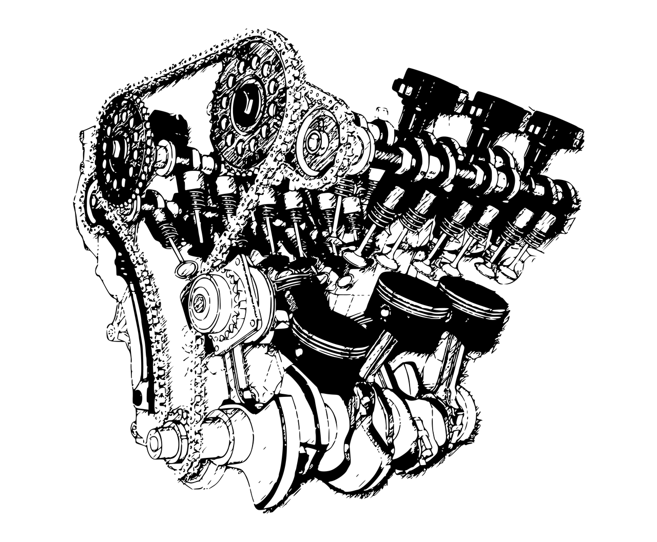
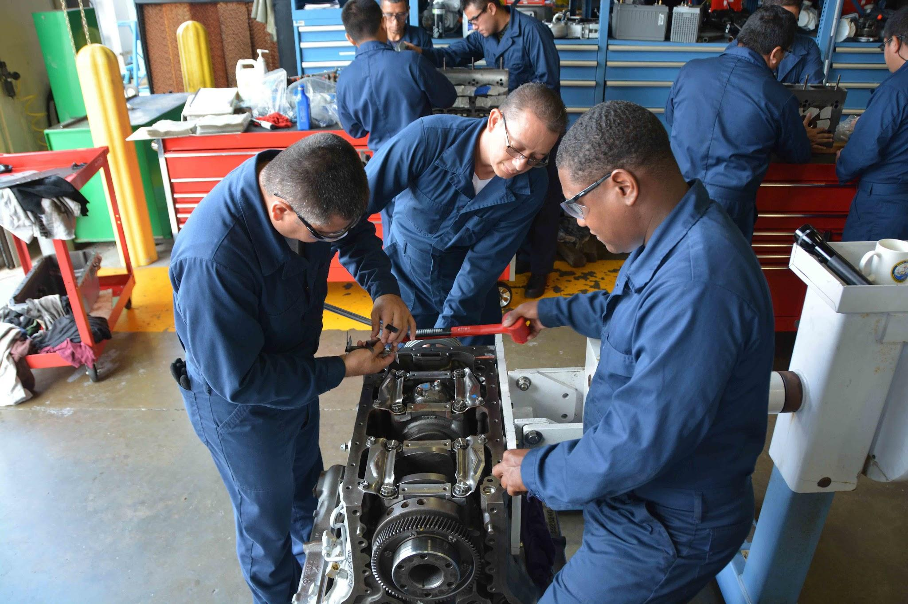
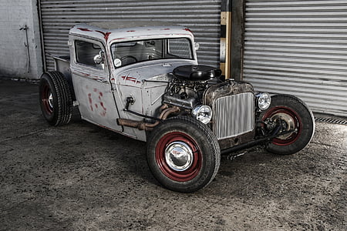
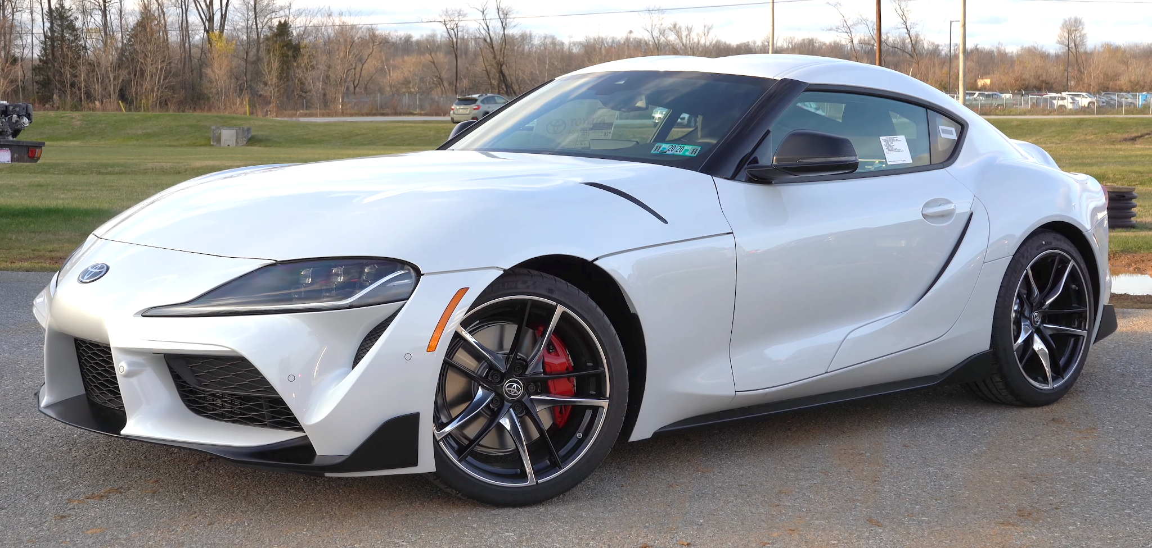
Mr. Lopez/Automotive Technology 1 & 2
Toyota TECS 1 & 2 WHS 2023-2024
Room K7
Hello, and welcome to Automotive Technology!
Wednesday September 27, 2023

Slide 2
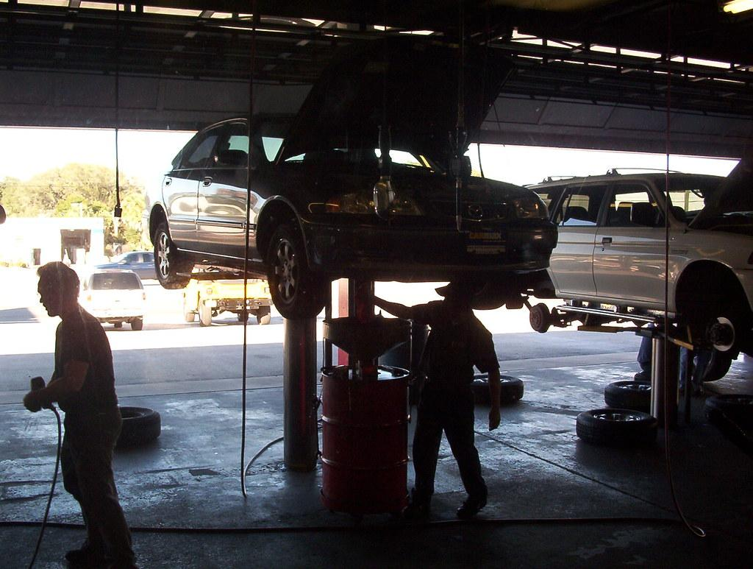
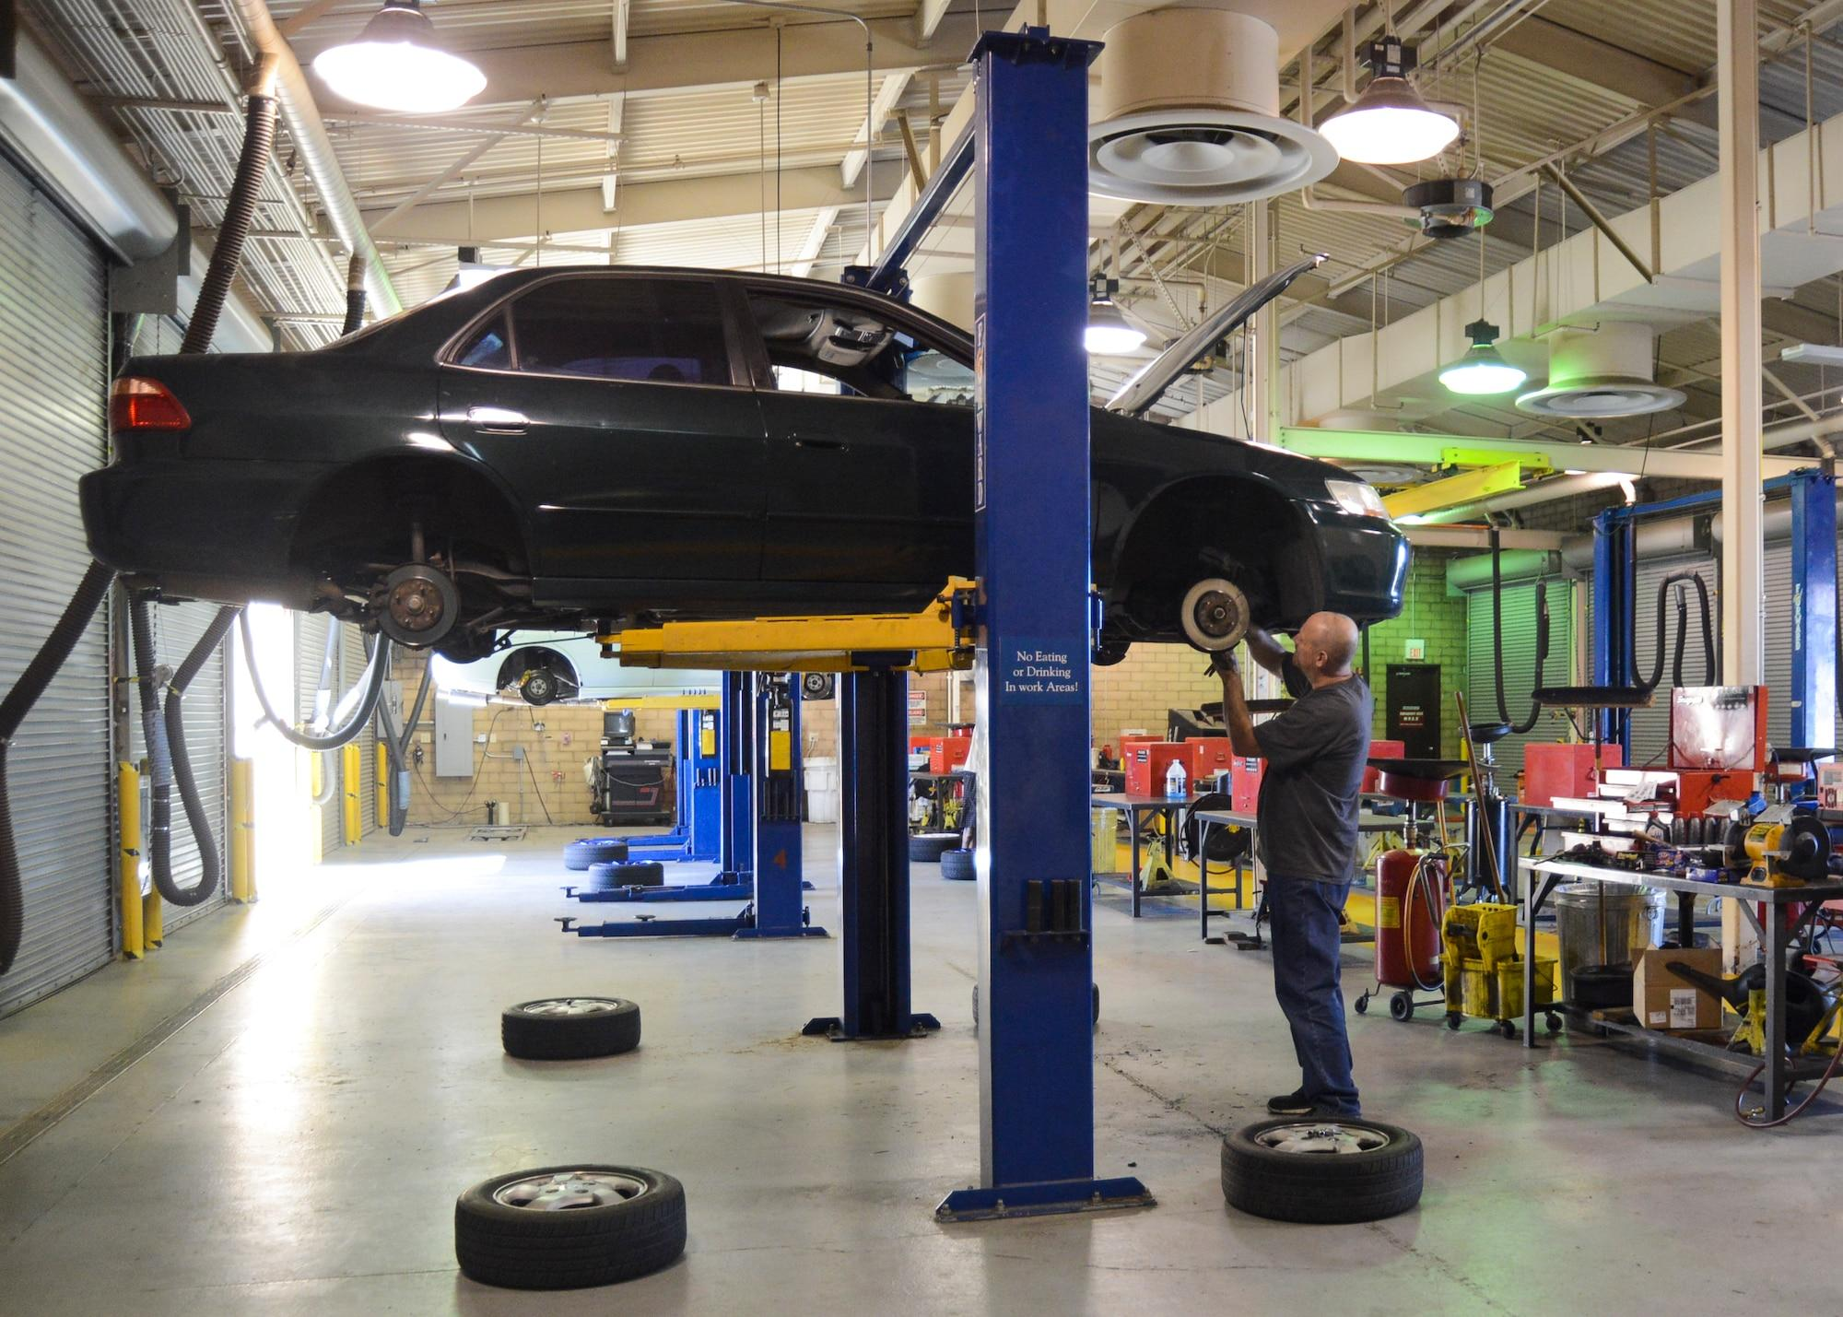
Hello, my name is Mateo Lopez and I am happy to be teaching your students about automotive technology and shop safety!
Maintenance!
Brake Repairs!
By the end of the school year, your students will know how to do these things and more!

Slide 3
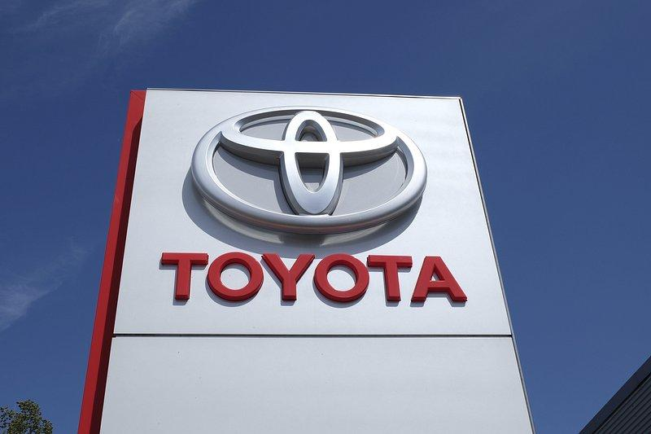
What you can learn in Automotive Technology!
Focused on safety first!
Toyota TECS first year learn the Toyota brand and earn some Toyota certifications as well as maintenance and repair skills
Second year classes build on first year knowledge to learn advanced repair and diagnostic skills
First year classes learn about careers, auto maintenance and general repair.
Second year Toyota TECS learn Toyota specific diagnostics and Toyota technology plus more certifications
Toyota Certifications stay on students Toyota file and can be used to help get a job with Toyota

Slide 4
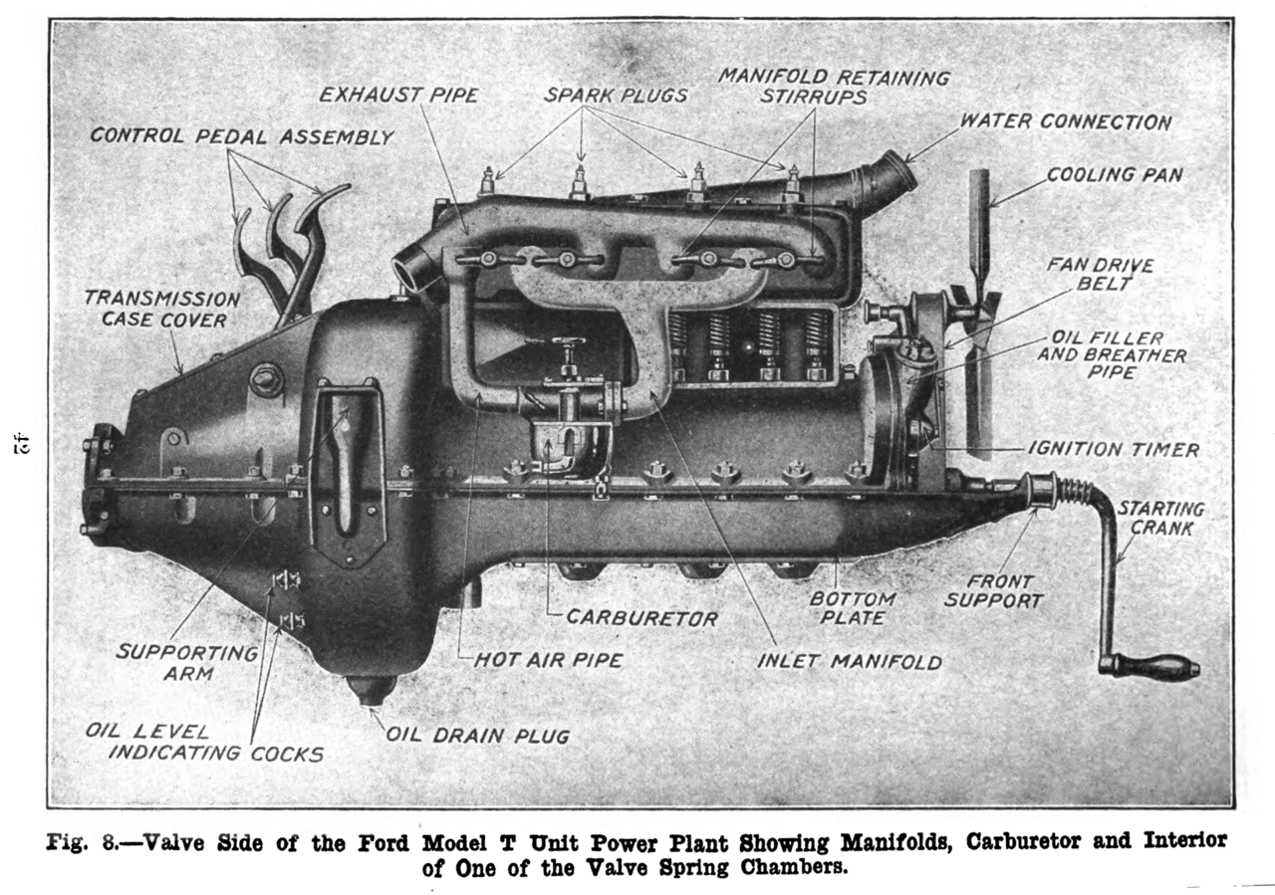
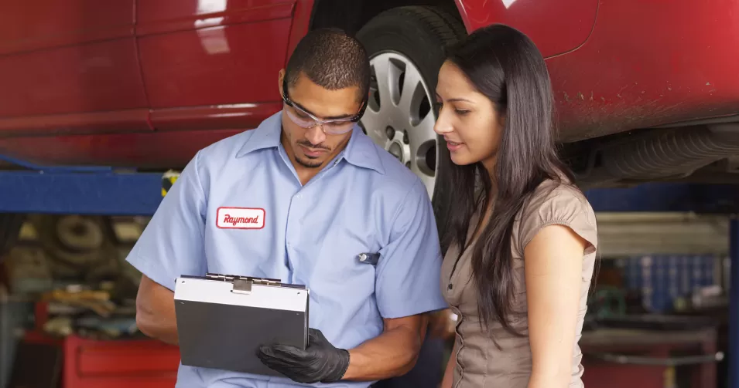
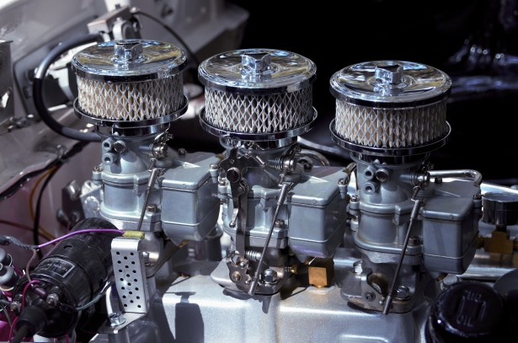
Thank you for coming to Back to School Night!
Questions?
Email: mlopez@hbuhsd.edu
Ph. 714-893-1381 ex 52177

