Slide 1
Engineering Pathway
Notes:
Welcome Slide

Slide 2
CAREER TECHNICAL EDUCATION
Engineering & Architecture Sector
Architectural/ Mechanical/ Electrical
Year 1 - Engineering Design
Year 2 - Engineering Design & Development
Courses are UC “F” Electives
75% + hands-on activities / projects
Notes:
CTE Pathways - Engineering & Architecture Sector / Engineering Design Pathway
MERITS Requirements
Meets VPA “F” College Admissions Requirements

Slide 3
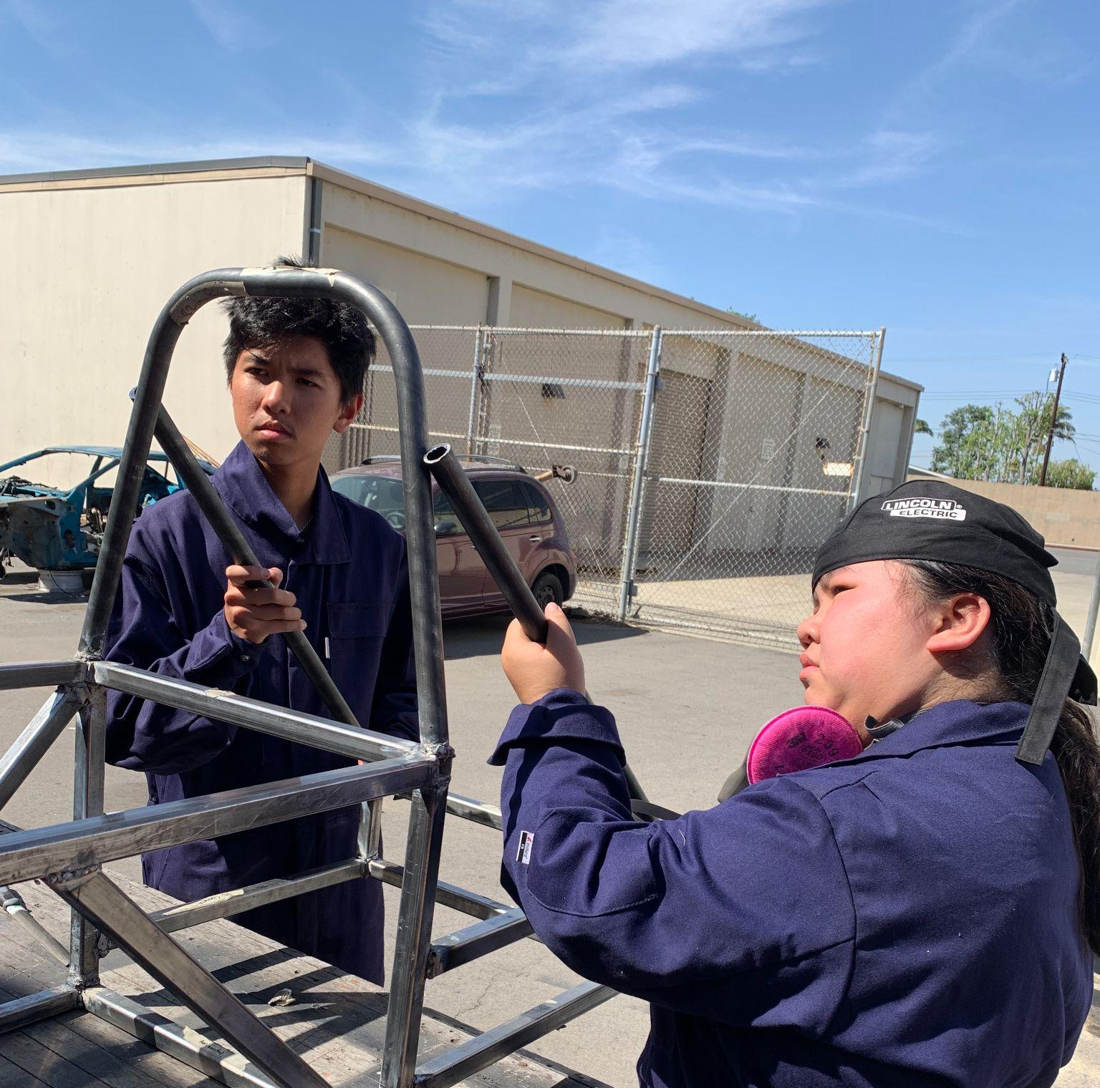
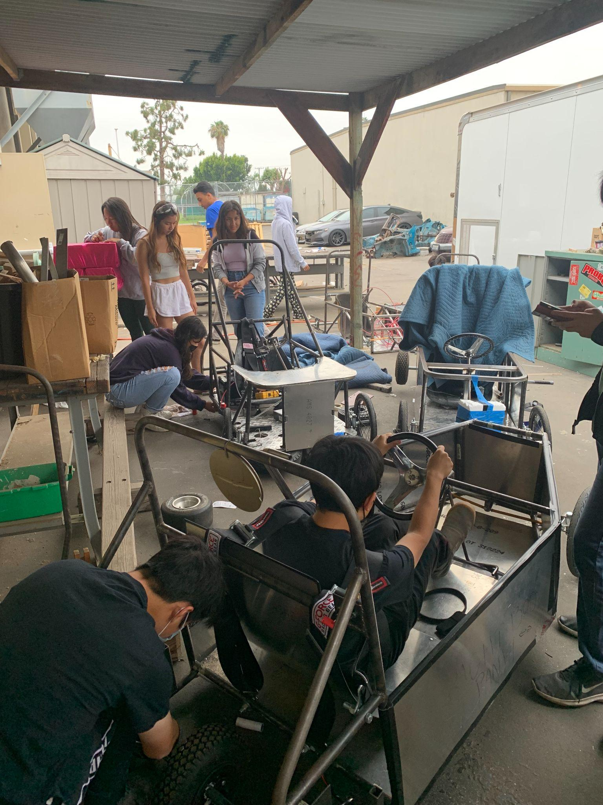
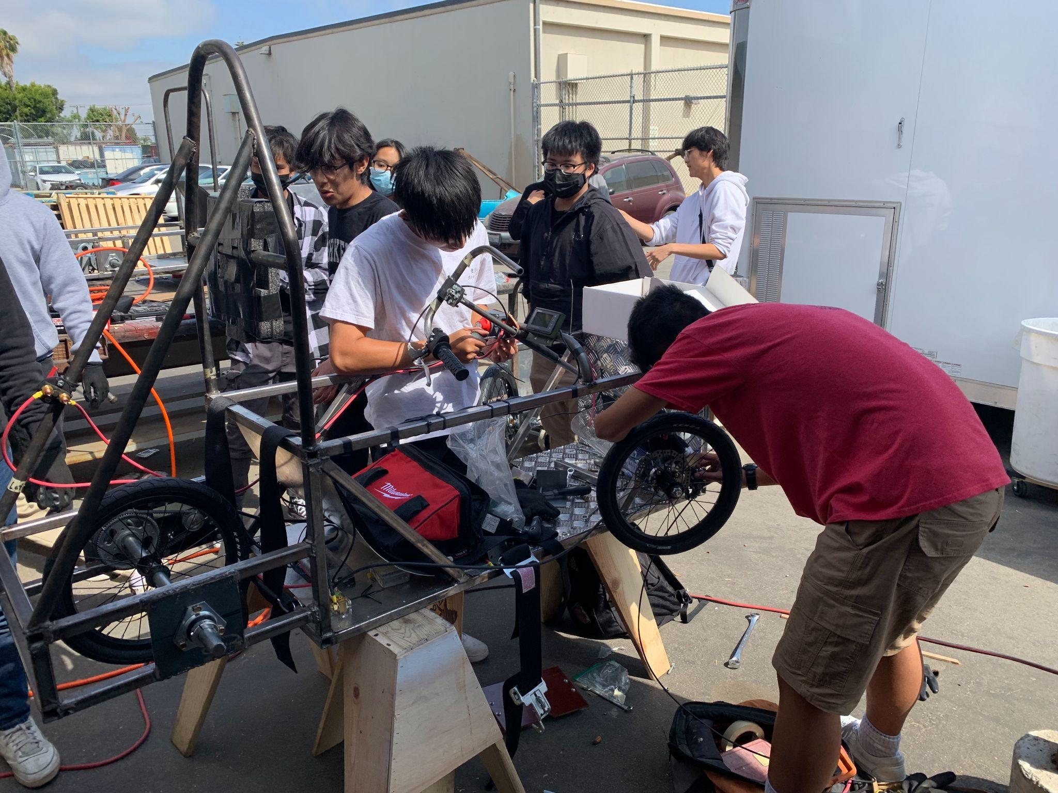
Engineering Design
Engineering Design & Development
Performing Rapid Visualization
Hand and Computer-Aided Drafting (CSWA)
Executing Material Performance Assessments
Designing, Fabricating, Testing, Reporting, and Manufacturing an Electric Vehicle
Building and Experimenting With DC Circuits
Attending Field Trips
Competing in Engineering Challenges
Reverse-Engineering Common Products
Developing Marketing and Distribution Materials
Research-Based Testing and Modifying an Internal Combustion Engine
Fabricating Based On Mechanical Limitations of Raw Materials
Teaching the Engineering Design Process to Year-1 Students Through an Electric Vehicle Build/Performance Assessment
Applying DC Circuit Design to Increase Return-On-Investment AND Increased Performance in Electric Vehicles
Notes:
Major Outcomes of the course

Slide 4
Performance-Based Grades
3 - Student demonstrates mastery of the aligned pathway or foundation standard
2 - Student demonstrates inconsistent mastery or only partial mastery of the aligned pathway or foundation standard
1 - Student does not demonstrate mastery, or has failed to address the objectives of the task/assignment/activity
0 - Student has not submitted evidence of mastery
What matters most? Earning a “point” or demonstrating mastery?
Translation?
GRADE | RANGE HI | RANGE LOW
A | 100 | 79.5
B | 79.4 | 59.5
C | 59.4 | 39.5
D | 39.4 | 19.5
F | 19.4 | 0
EFFORT has VALUE!

Slide 5
gberger@hbuhsd.edu
714-893-1381, extension 52174 AND 52175

