Slide 1
Entrepreneurship
Pathway
Business Essentials
Virtual Enterprise

Slide 2
Business Essentials
Business and Economics
Business Management
Marketing
Business Finance
Personal Finance

Slide 3
Real World Experience - Business Essentials
Yakult Factory Tour
Job Shadow
Junior Achievement Men’s Talk
Junior Achievement Young Women's Empowerment event

Slide 4
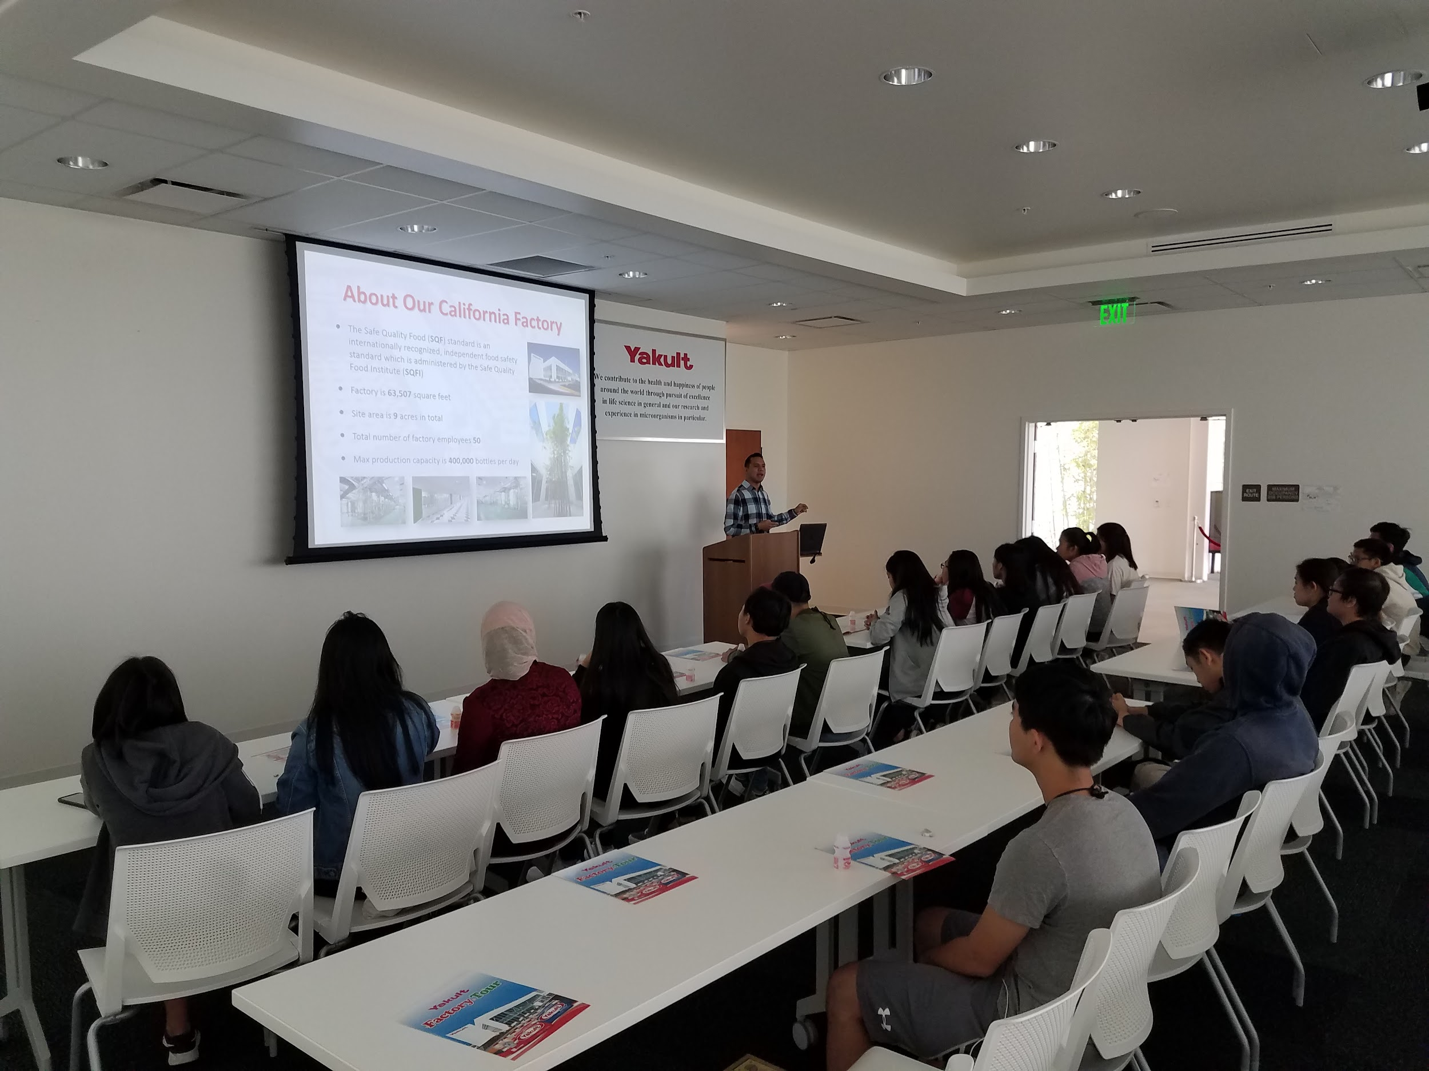
Yakult Factory Tour

Slide 5
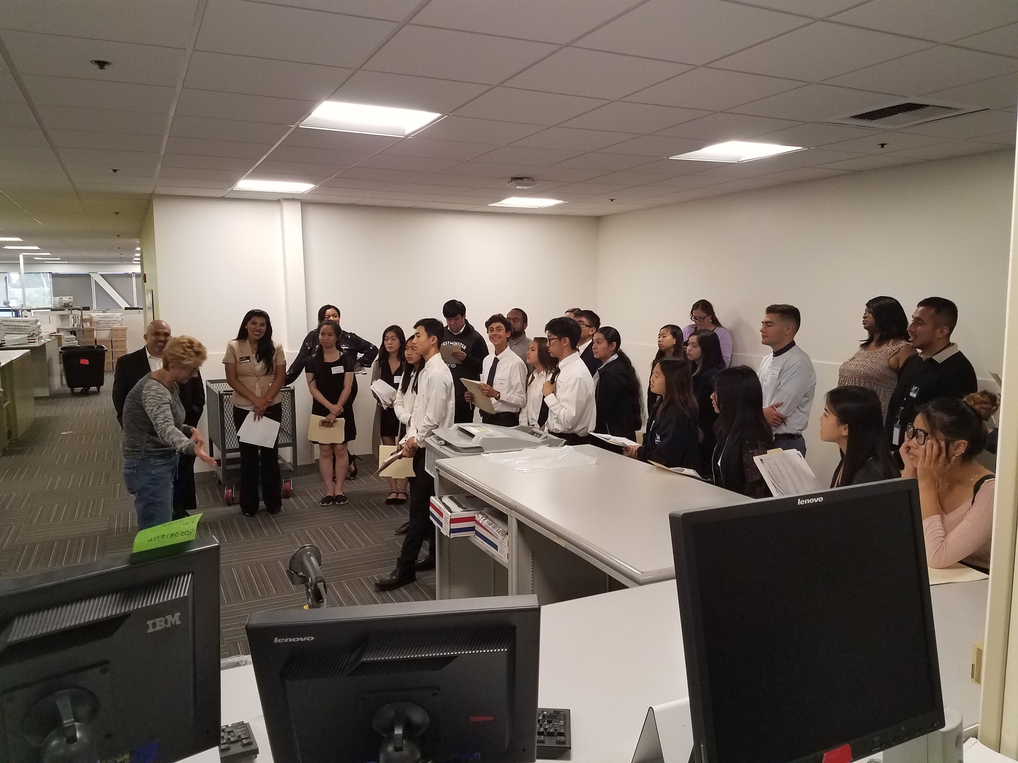
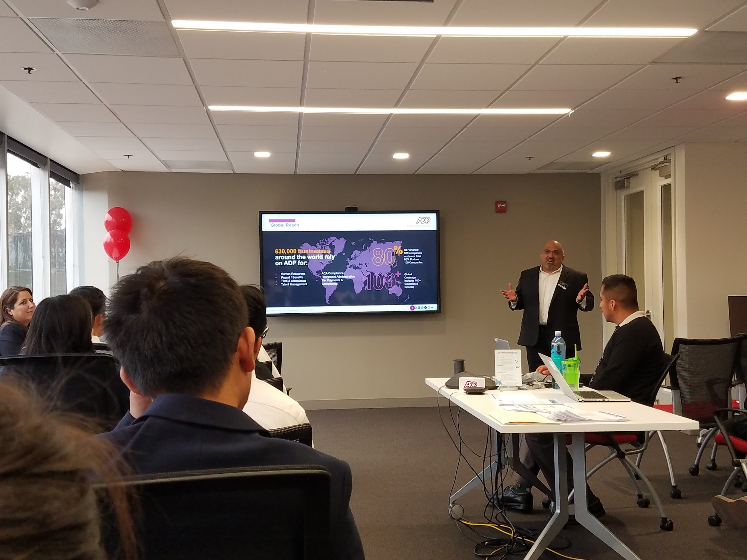
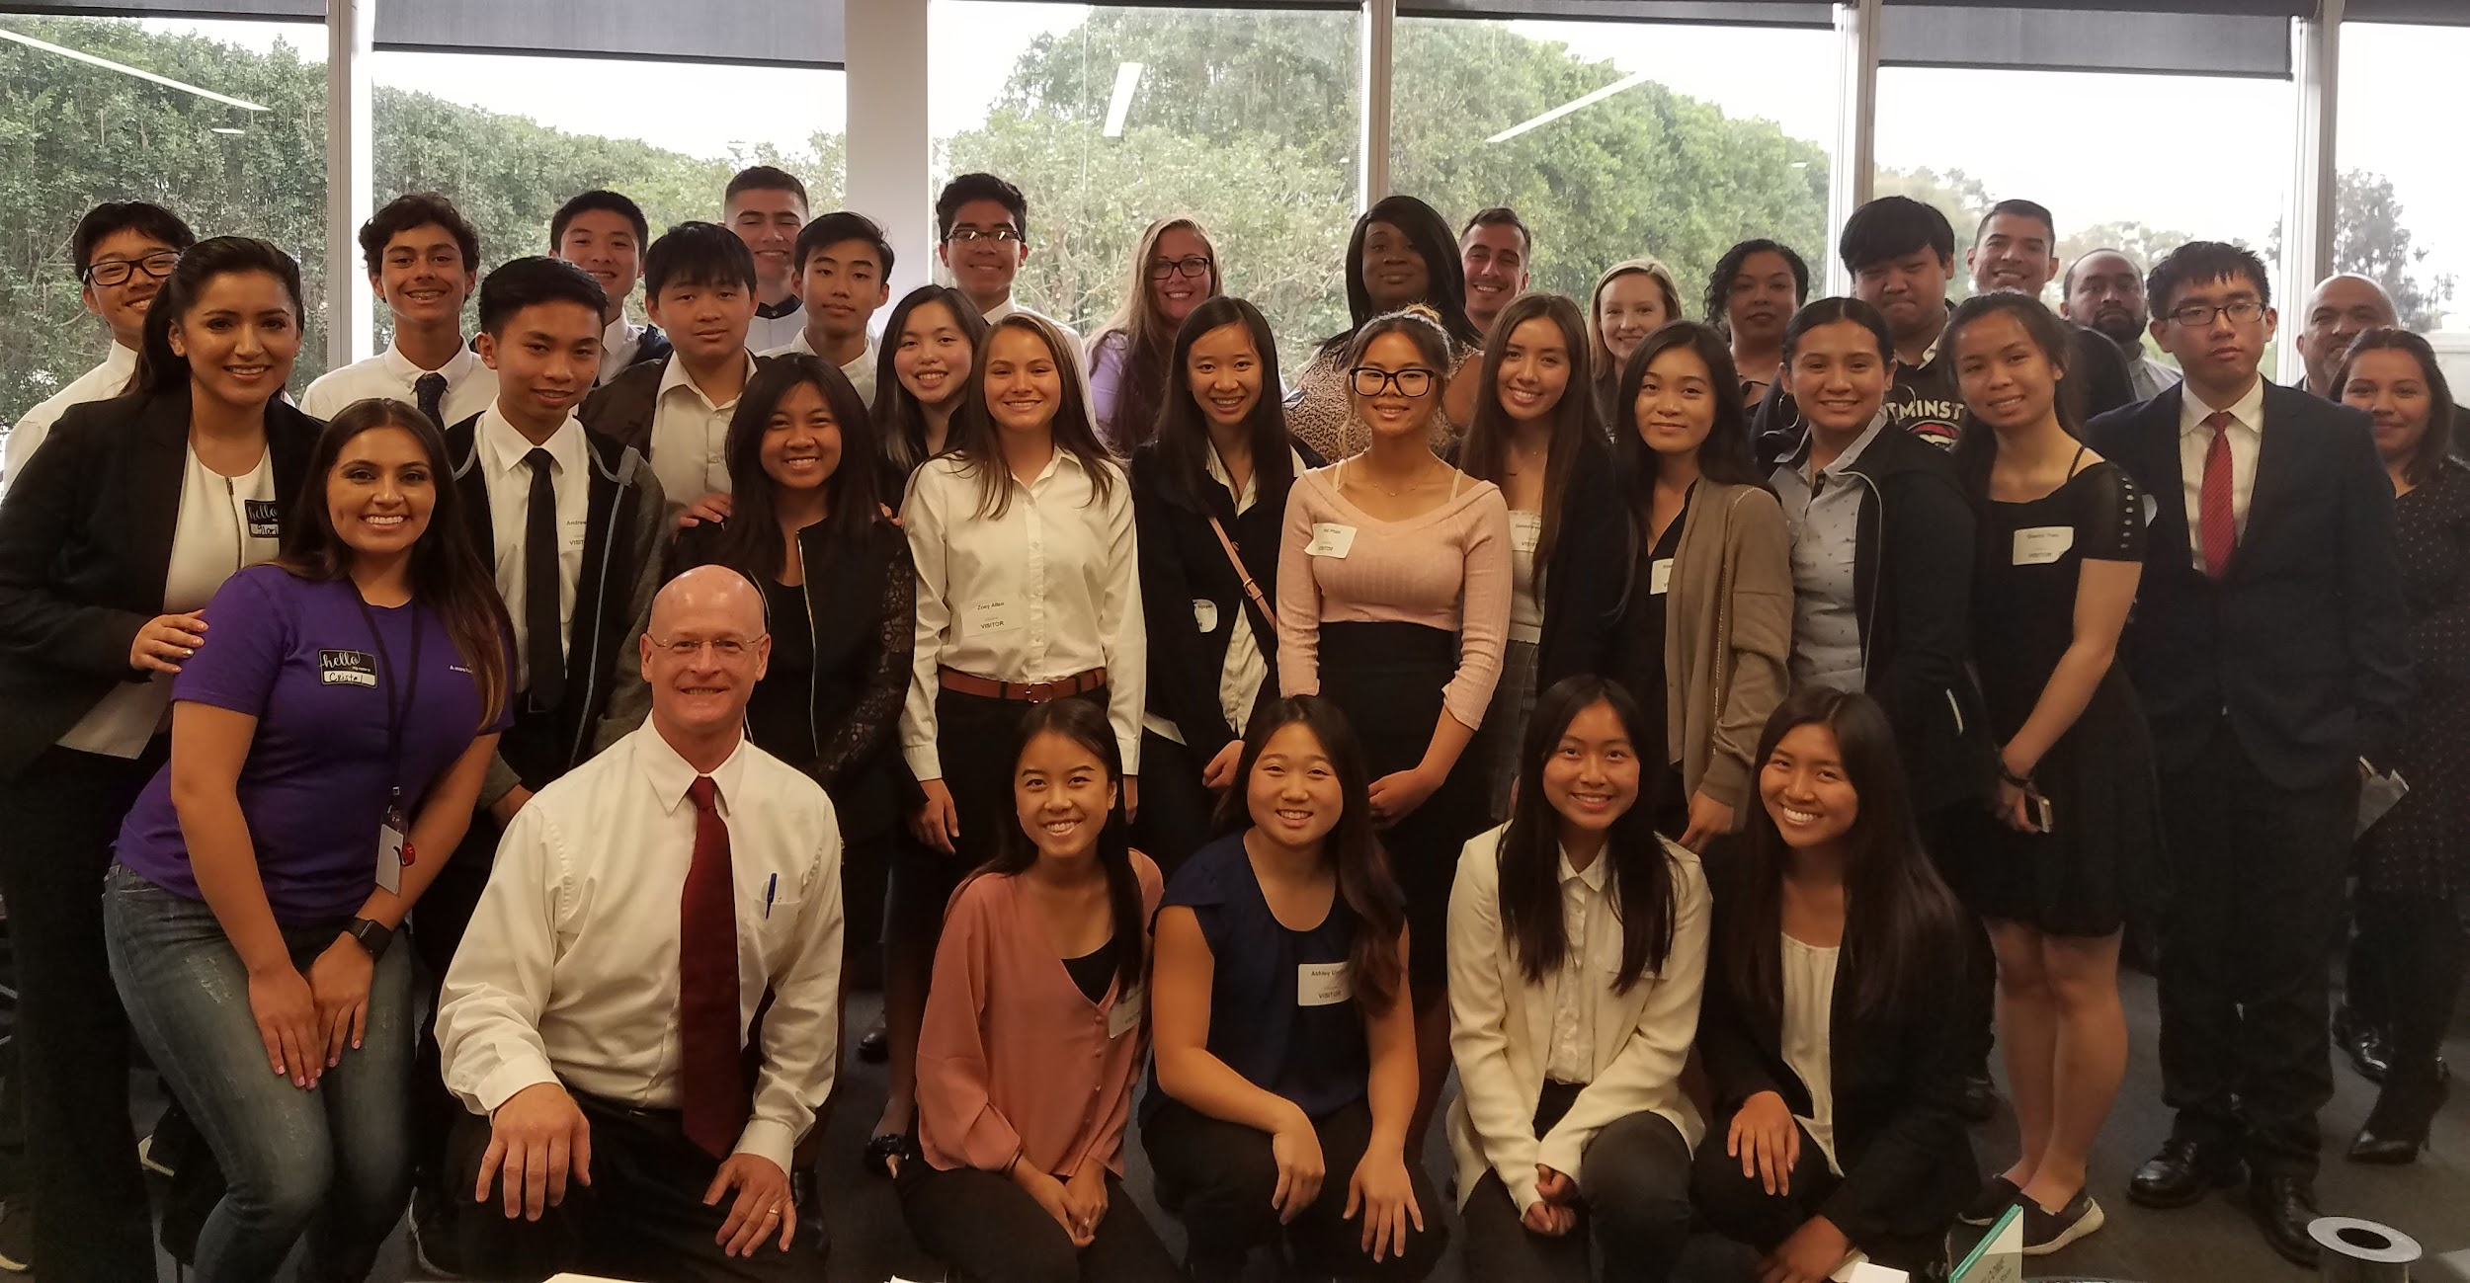
Job Shadow at ADP

Slide 6
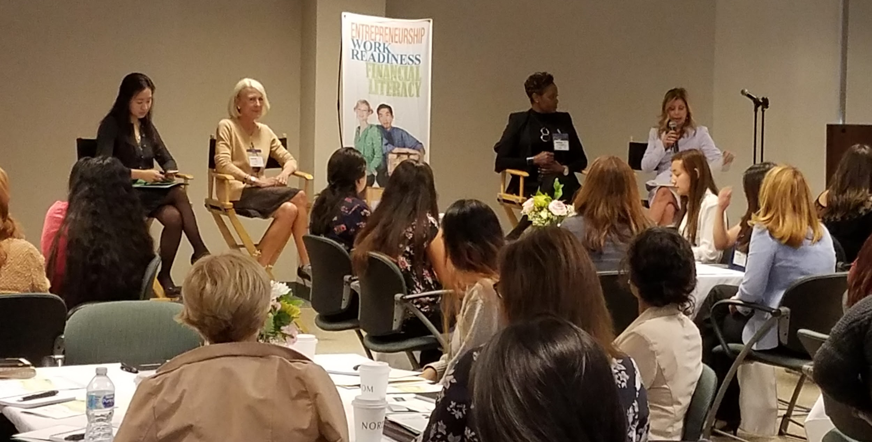
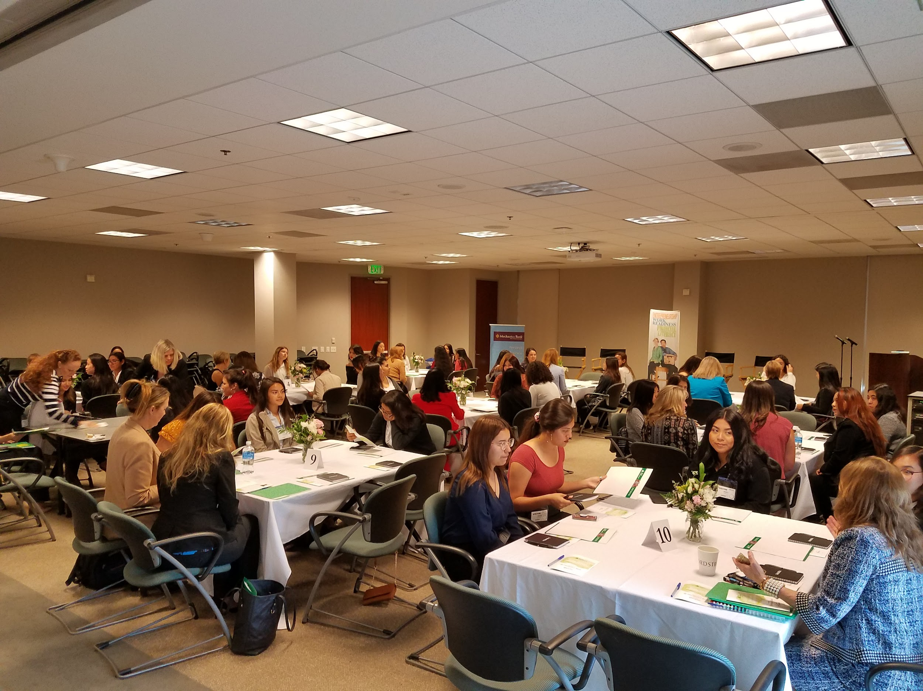
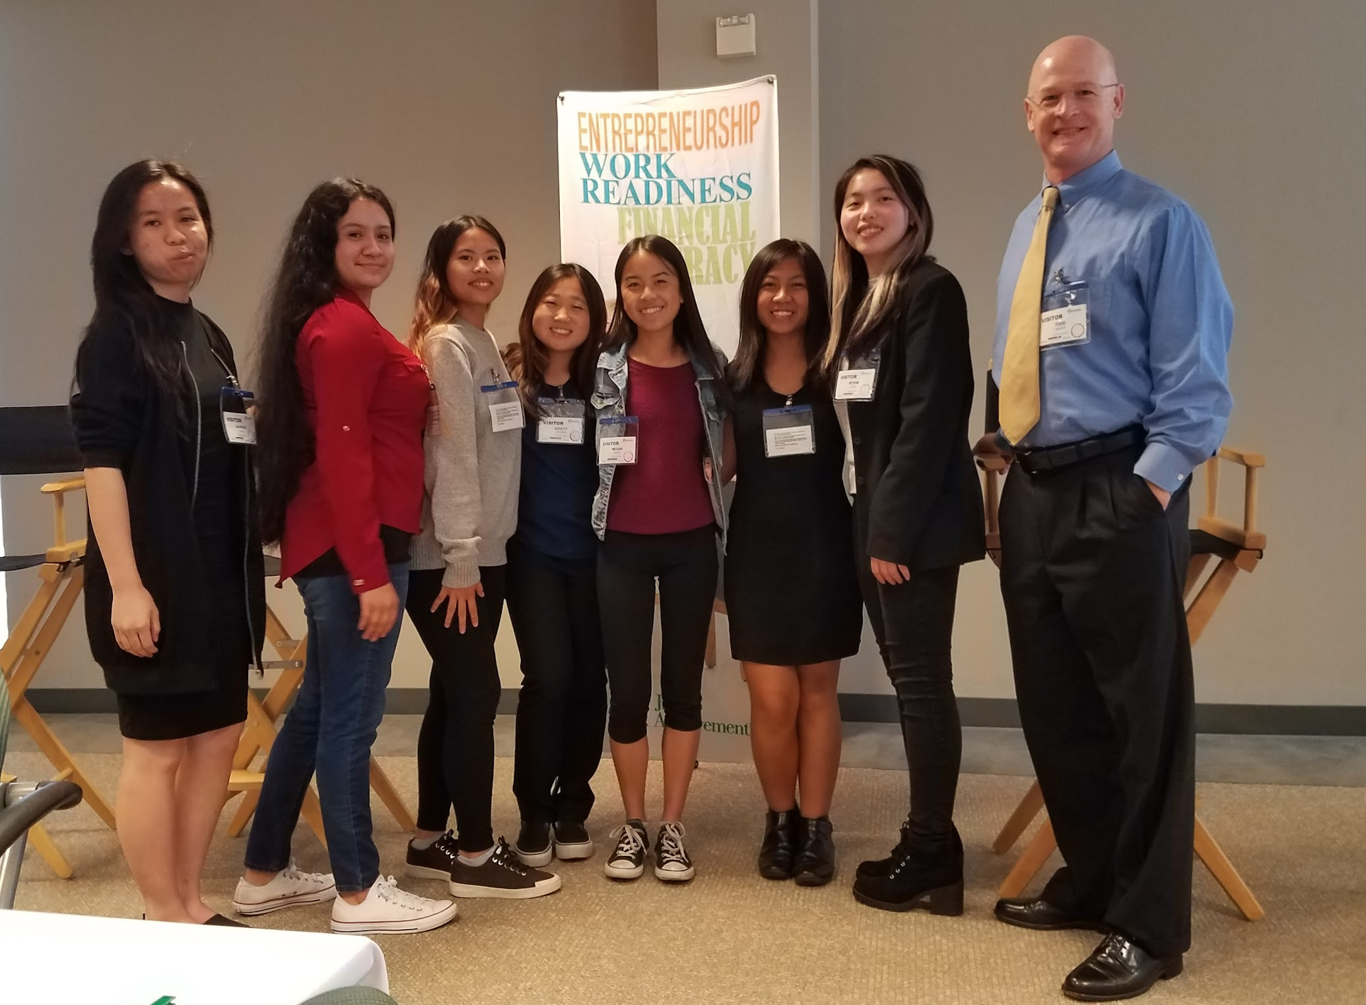
Junior Achievement Young Women’s Empowerment Event

Slide 7
Virtual Enterprise
Class is run by students
Students come up with business idea
Create a virtual business including - a functional website, business plan, marketing plan, financial statements, company newsletter just to name a few.
Students may attend trade shows in San Diego, Los Angeles, Bakersfield, and Oakland.
Students will compete in live and submission based competitions
Compete against schools from across California

Slide 8
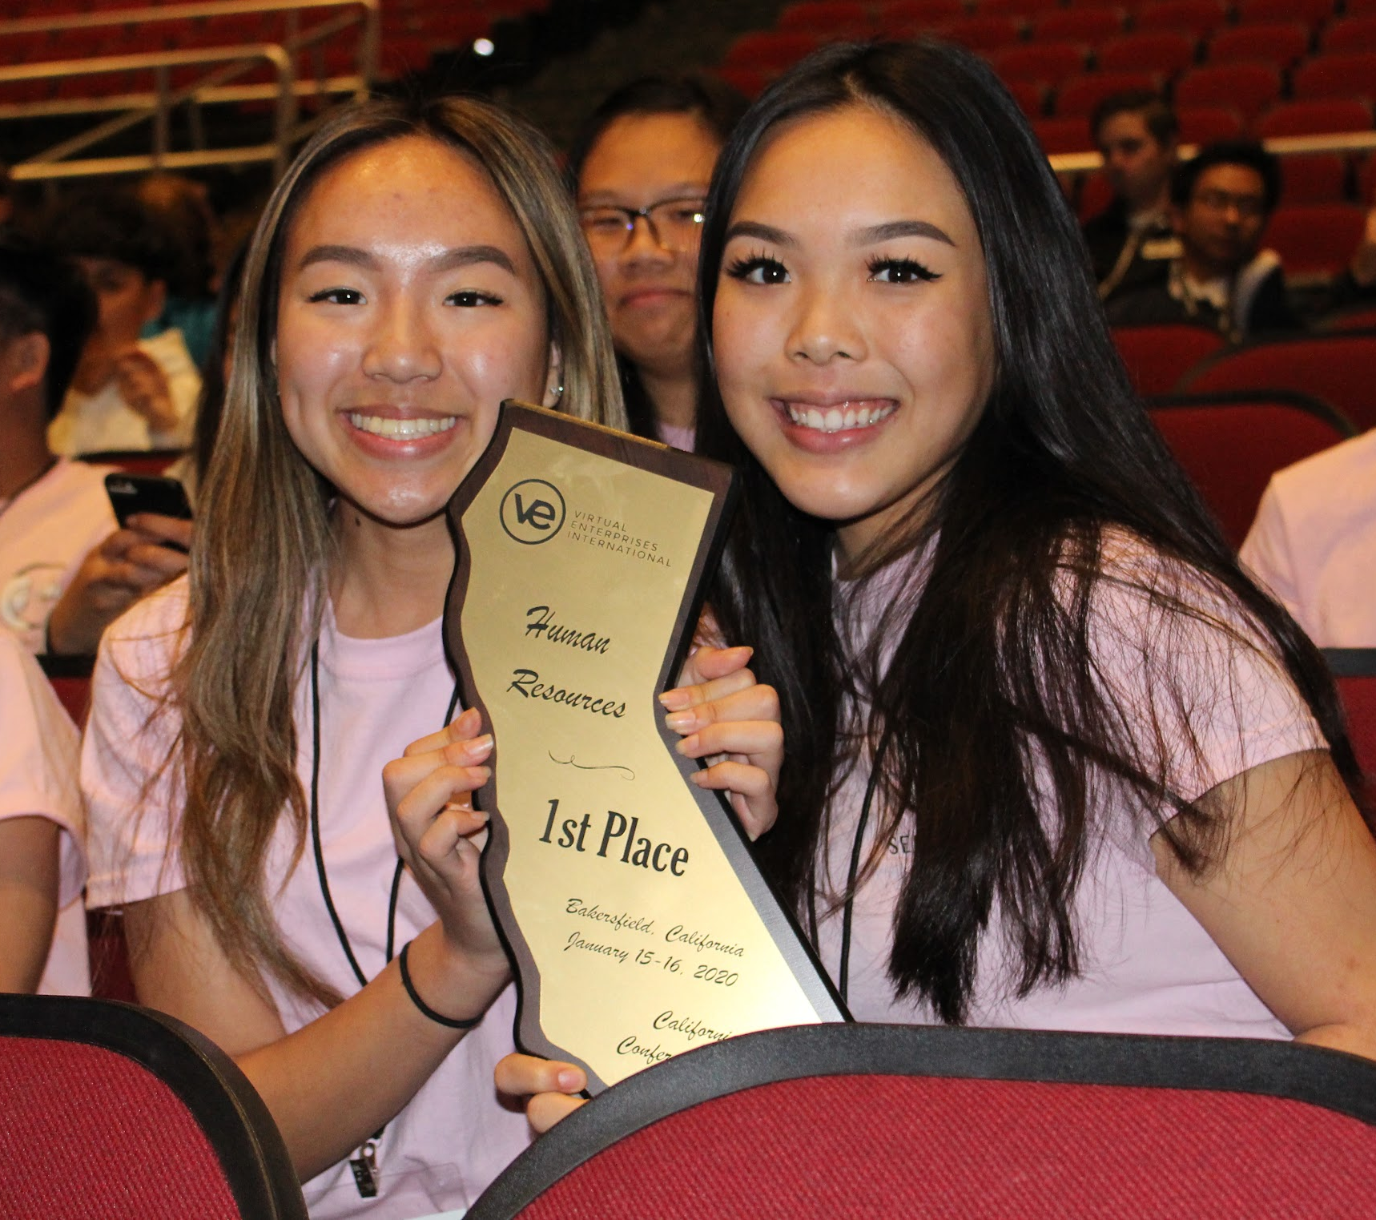
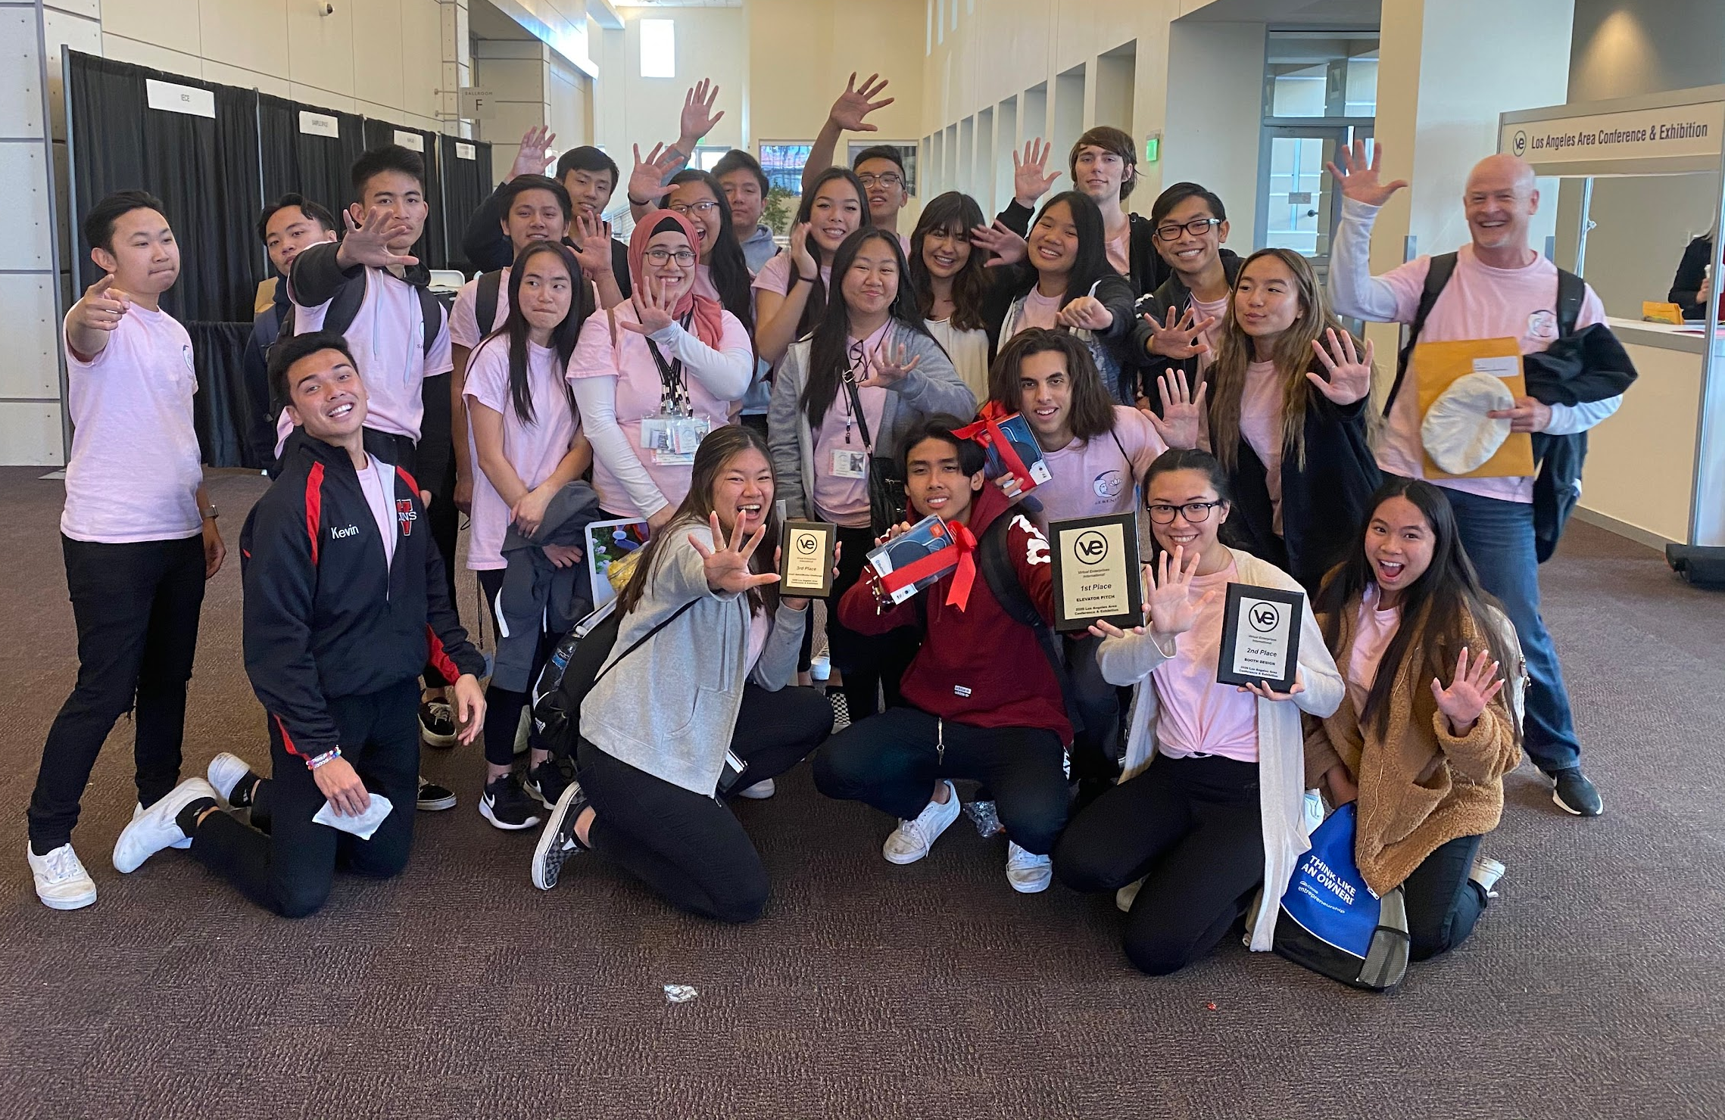
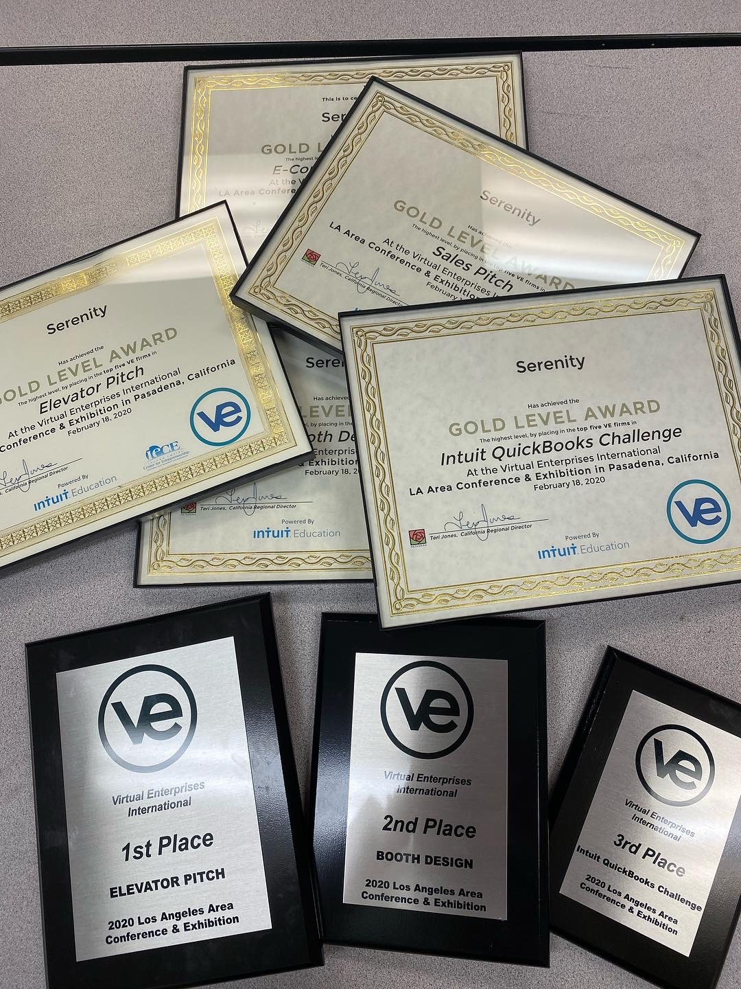
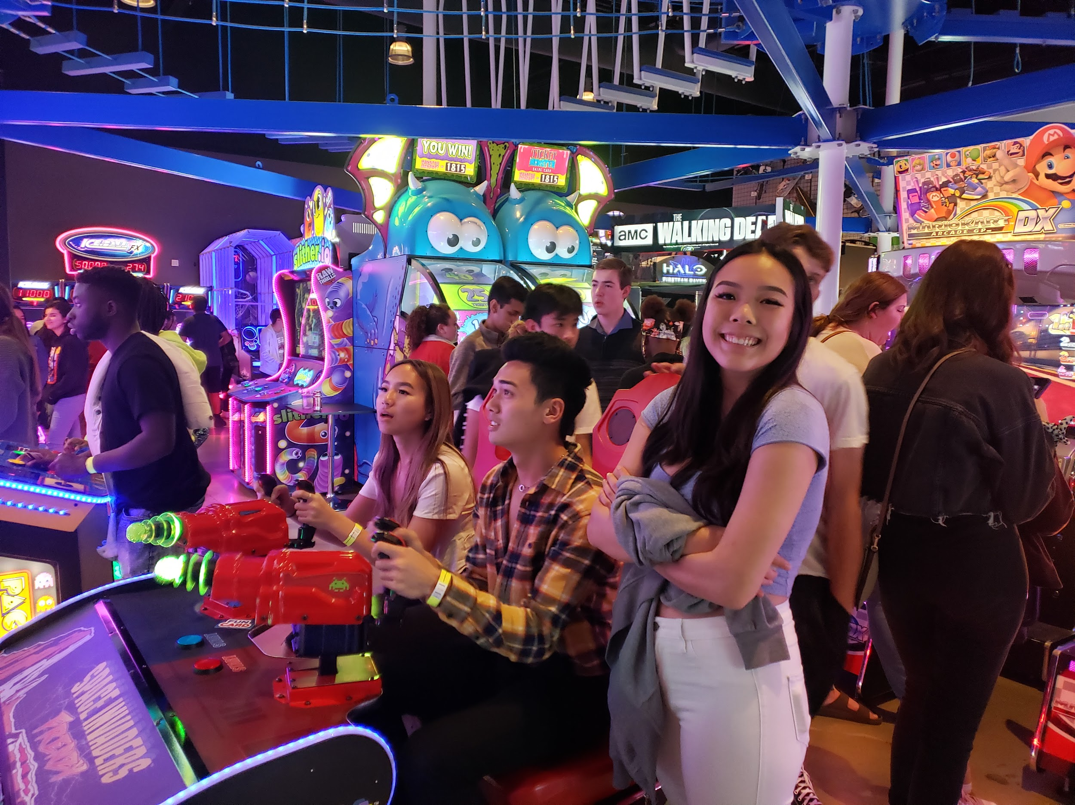
Trade Fairs

Slide 9
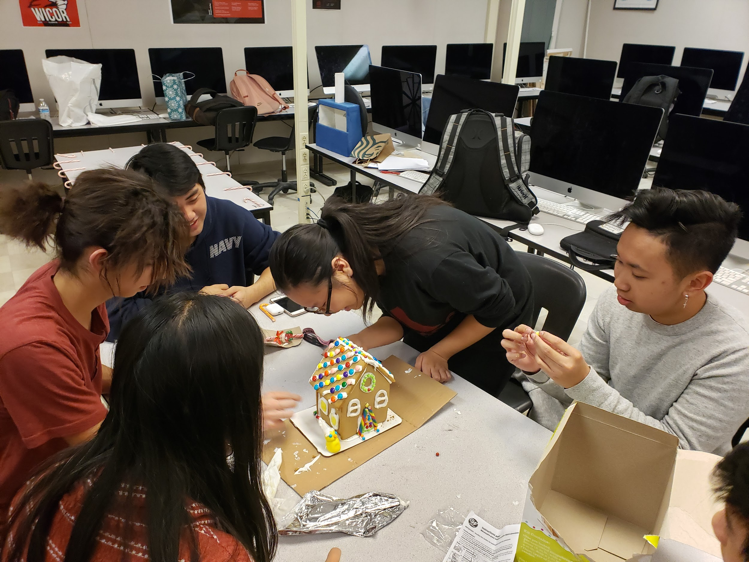
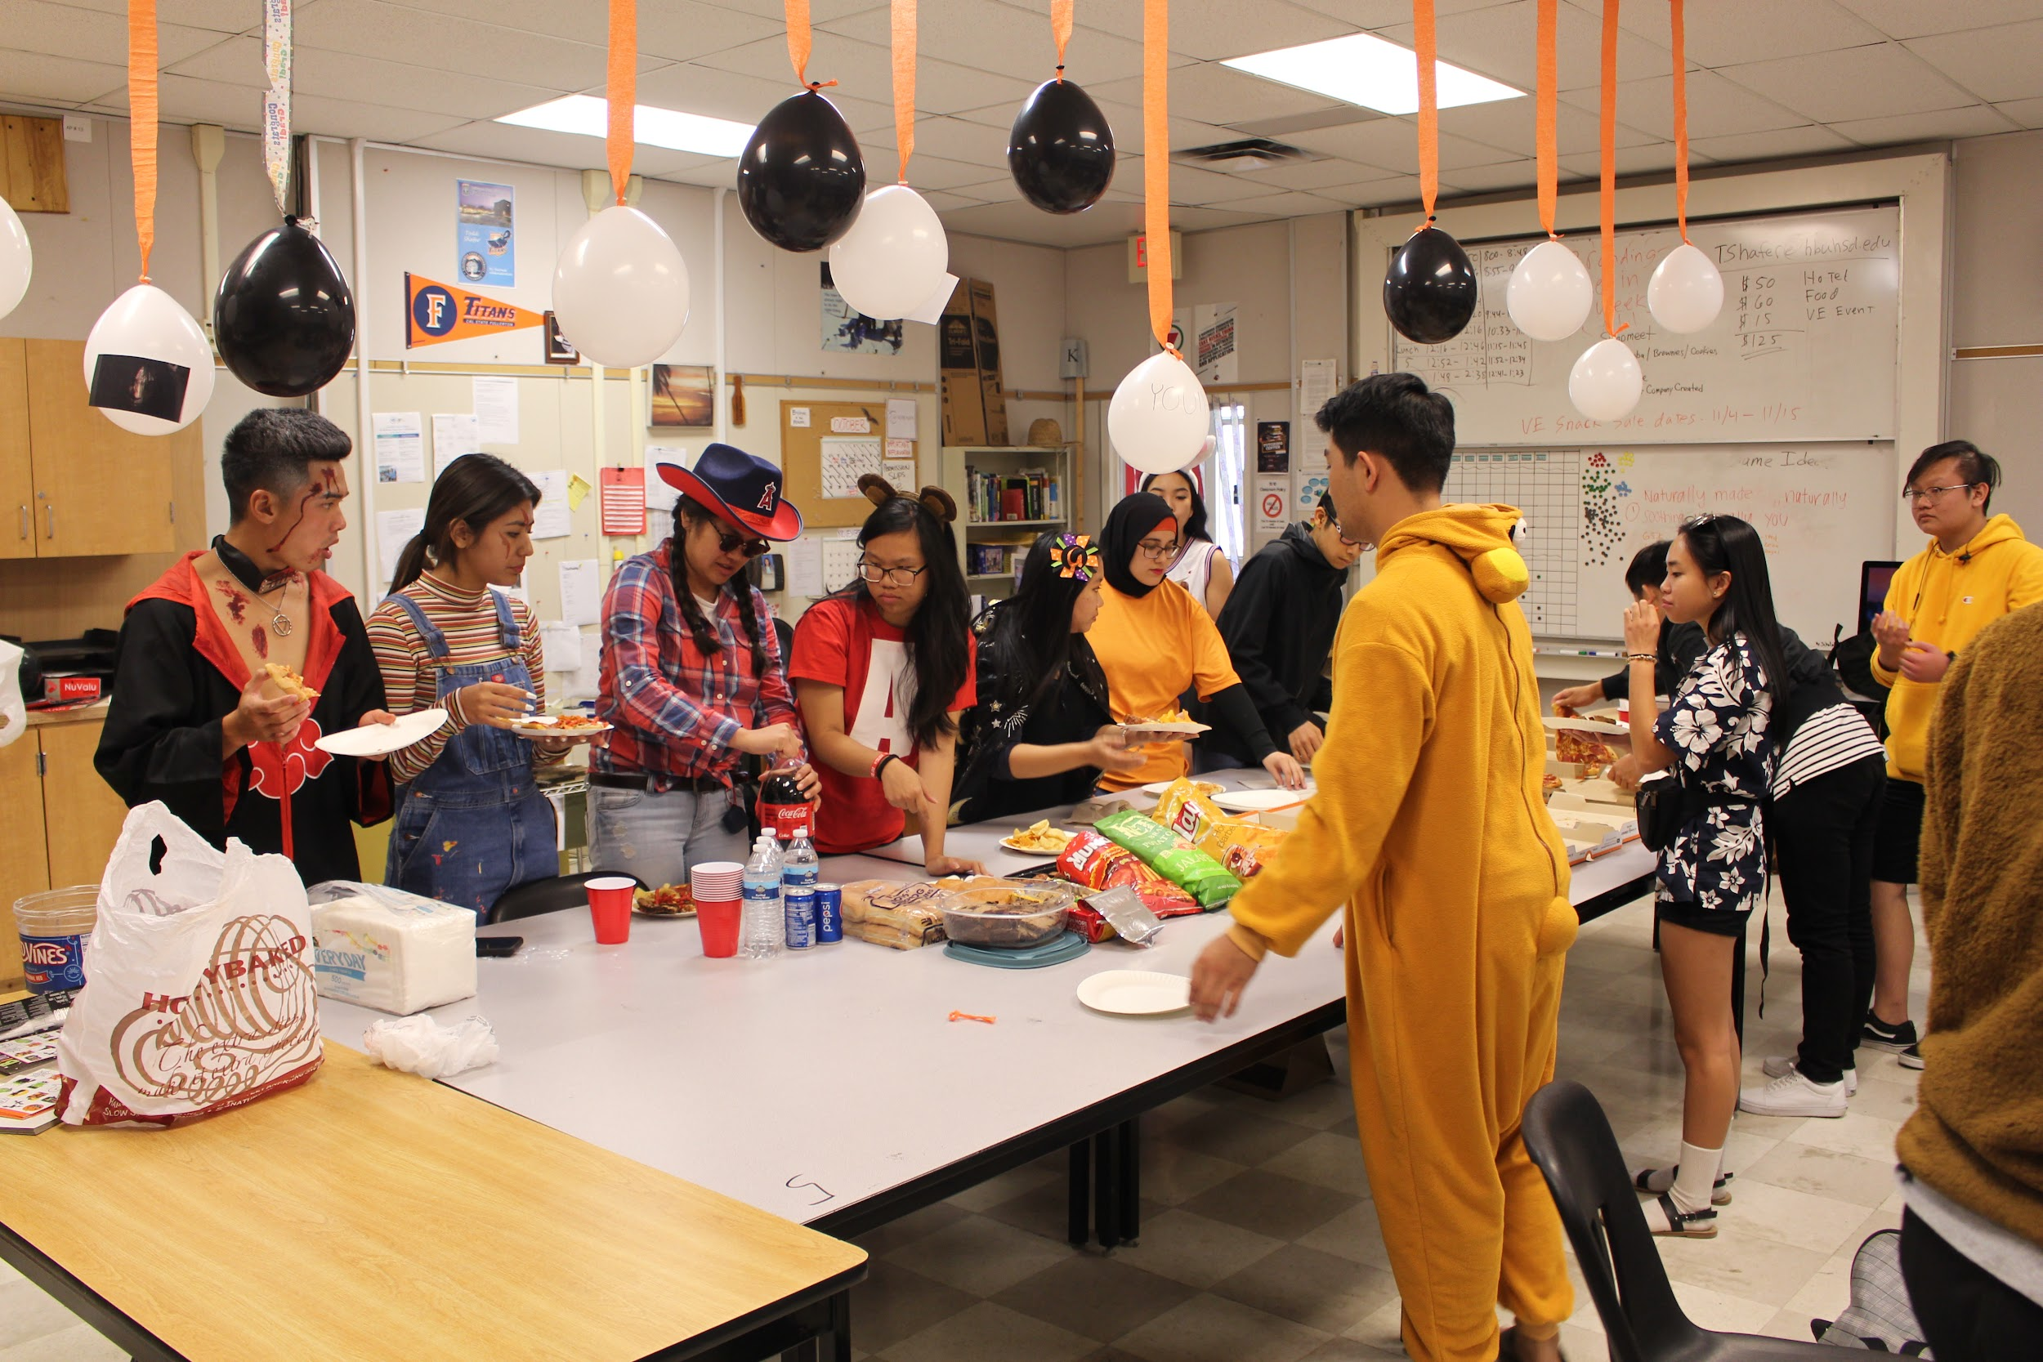
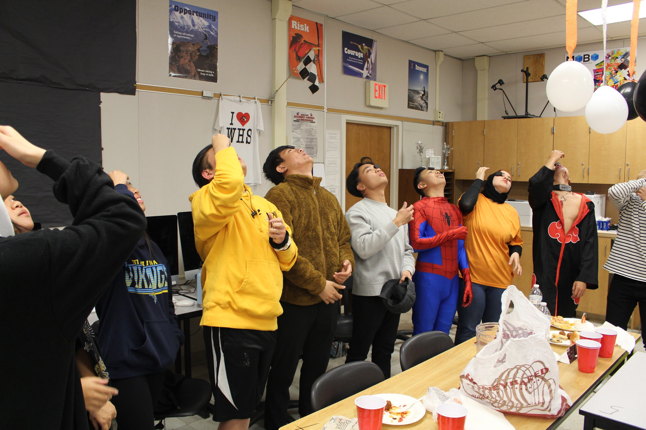
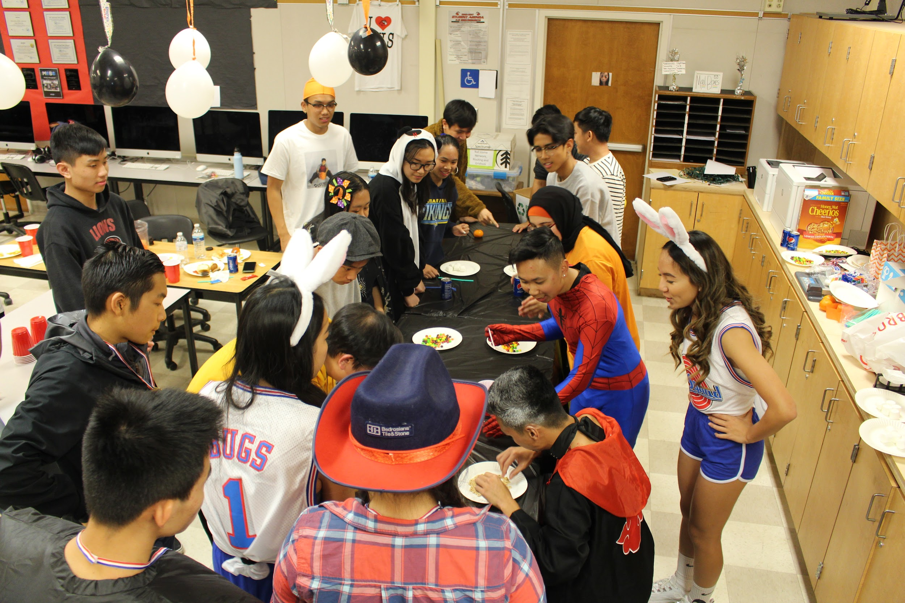
Company Parties

Slide 10
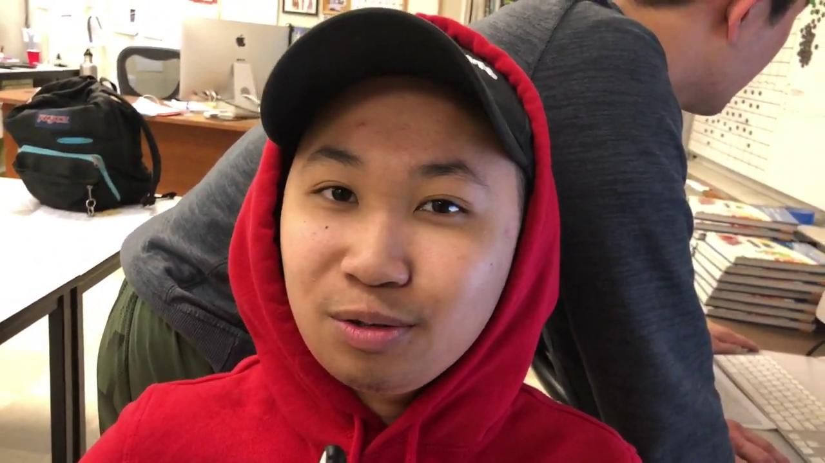
The VE Experience

