Slide 1
Game Design Pathway
Contact for more info Miss Võ. kvo@hbuhsd.edu

Slide 2
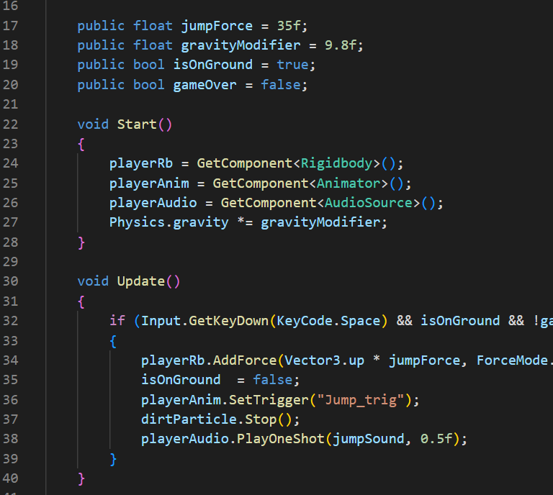
Script Fundamentals, Functions, & Properties
Basic commands in Scripting Language (C#)
Methods/Functions
Variables, Conditionals

Slide 3
Physics & Environment
Colliders, rigidbodies, force, torque, physics materials
Game environment, object placement, terrain, environ effects, skyboxes, navigation

Slide 4
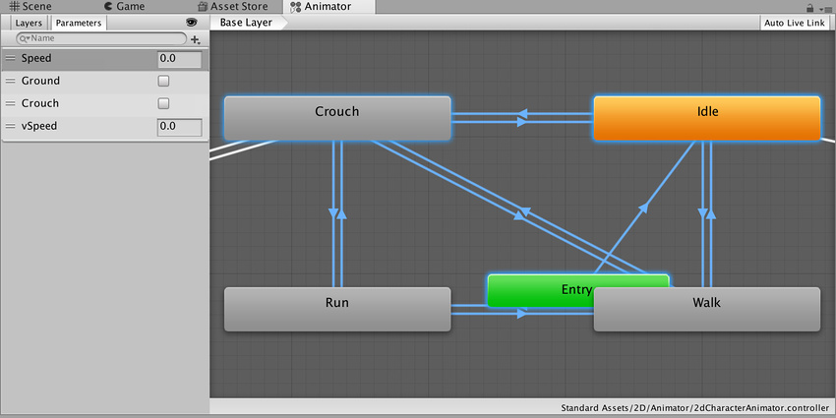
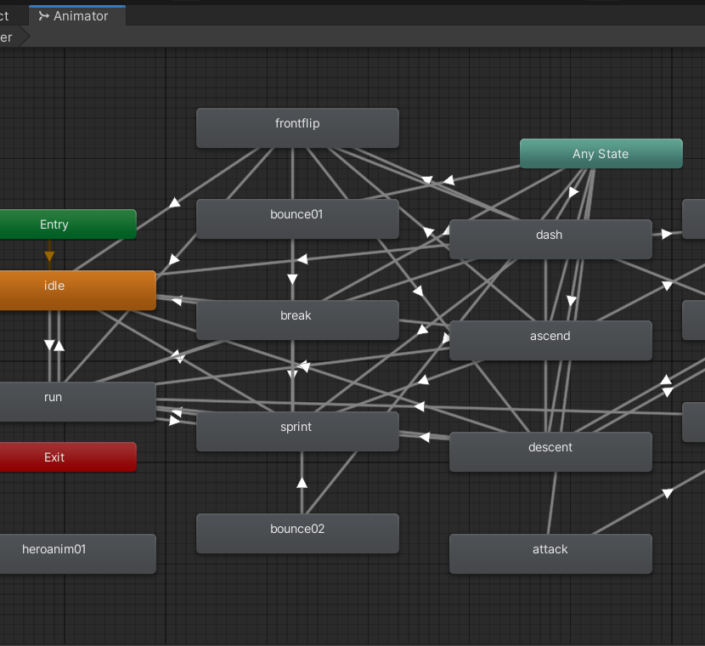
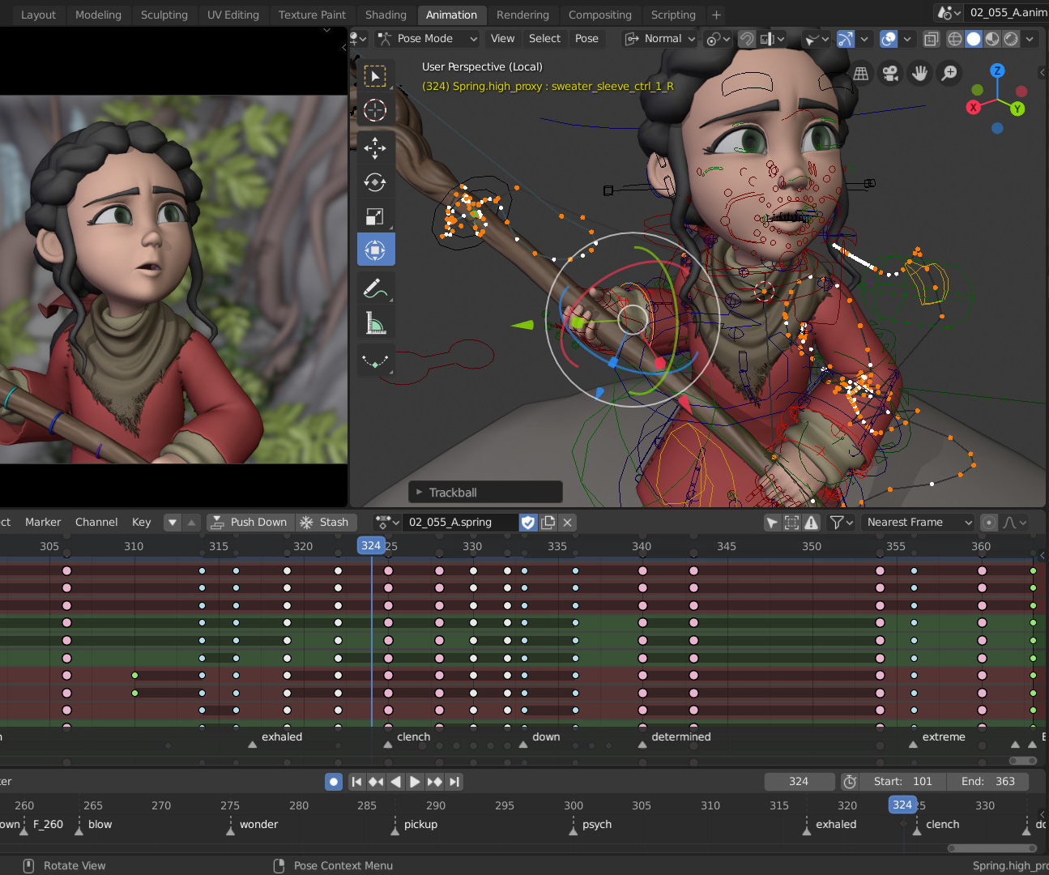
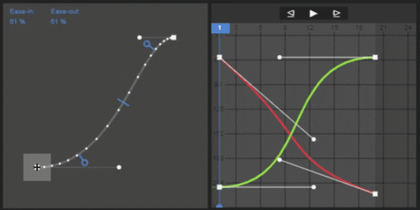
Animation
Animations in Editor
Advanced Animation Techniques, humanoid avatars
Blend Tree
Program in C#.
Build custom state machine.
Build a custom character controller for our character.
Build a custom rig for animating a character.
Animate basic actions:
idle, walk, run, jump, fall, throw, etc.

Slide 5
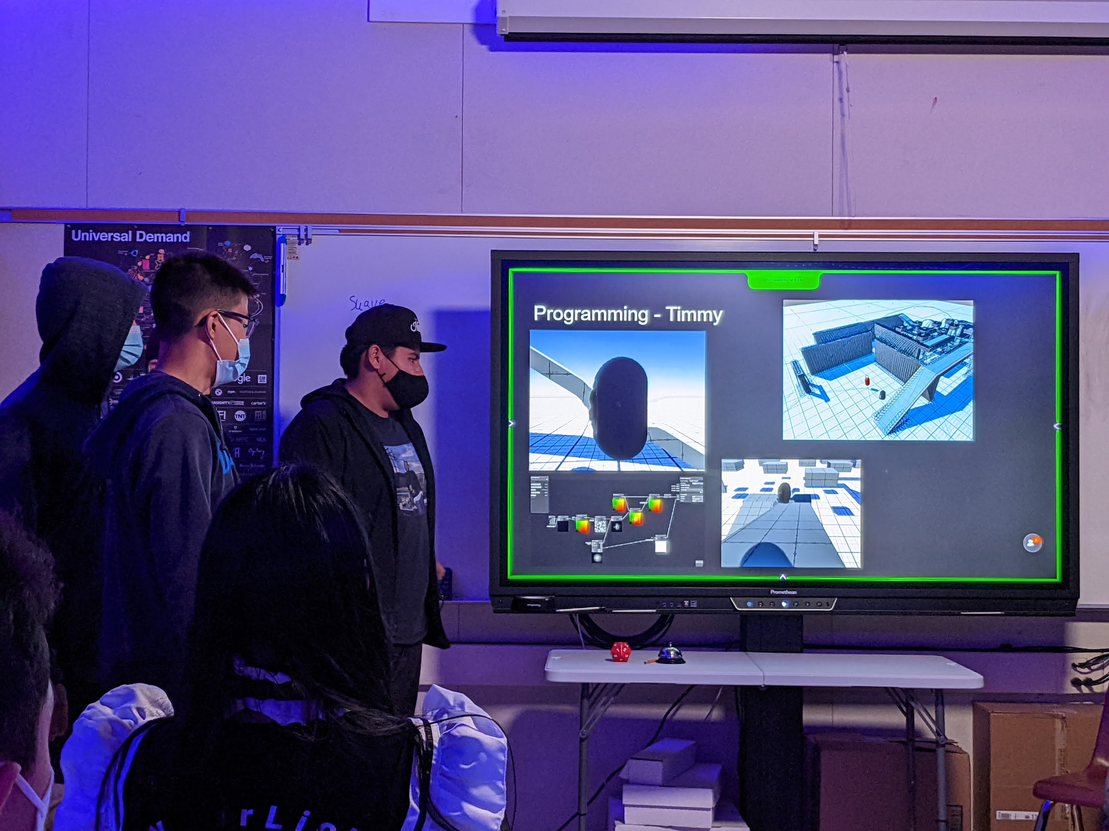
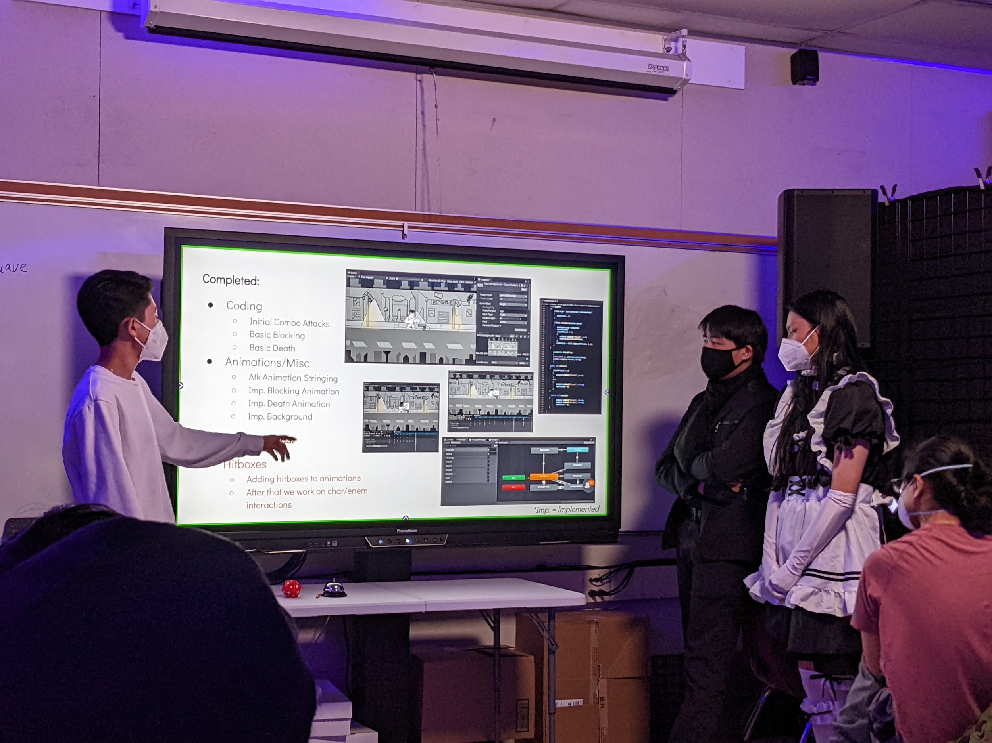
Constructs of Game Design
Level design
Goals/objectives + challenge/motivation
How players learn
Directing players
Level/scene transitions
Navigation
Graphic User Interfaces
Win/loss screens, game state
Balance
Prototype levels + Rough assets
Game mechanics: Movement & control + Interaction w/ objects & environment
Debugging

Slide 6
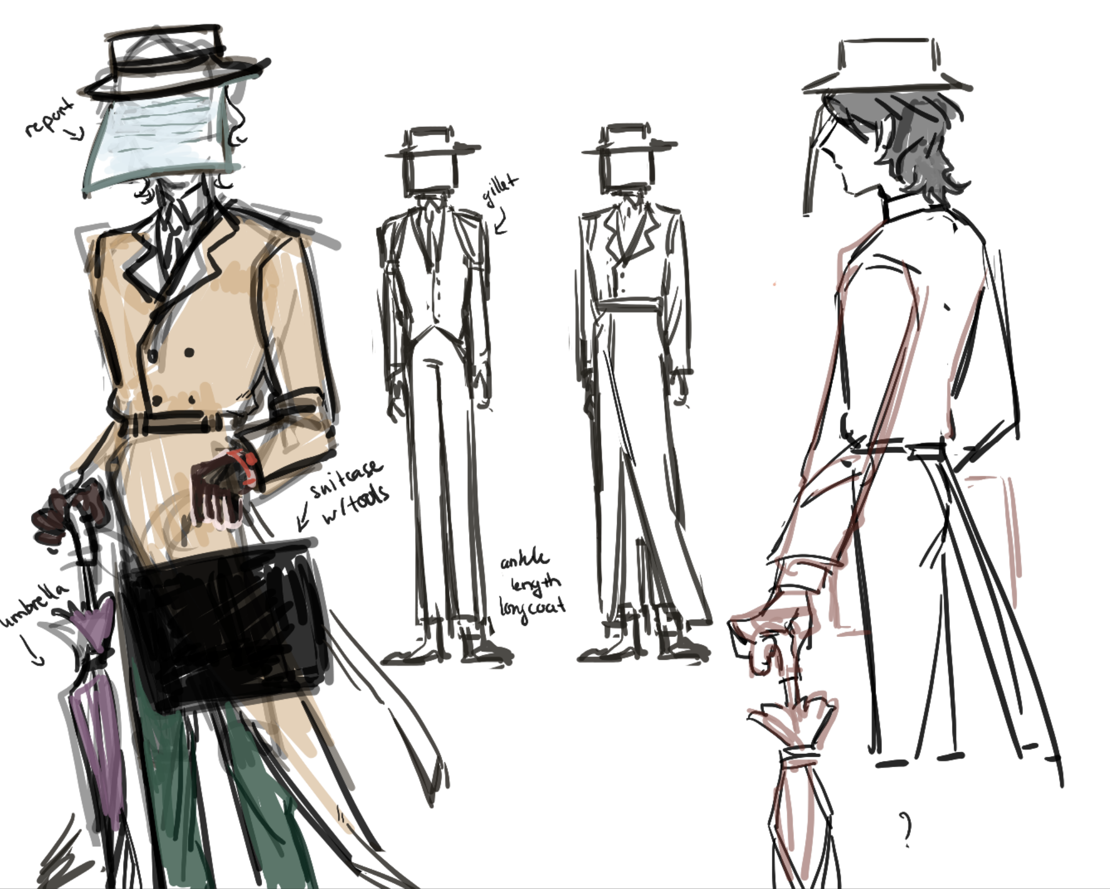
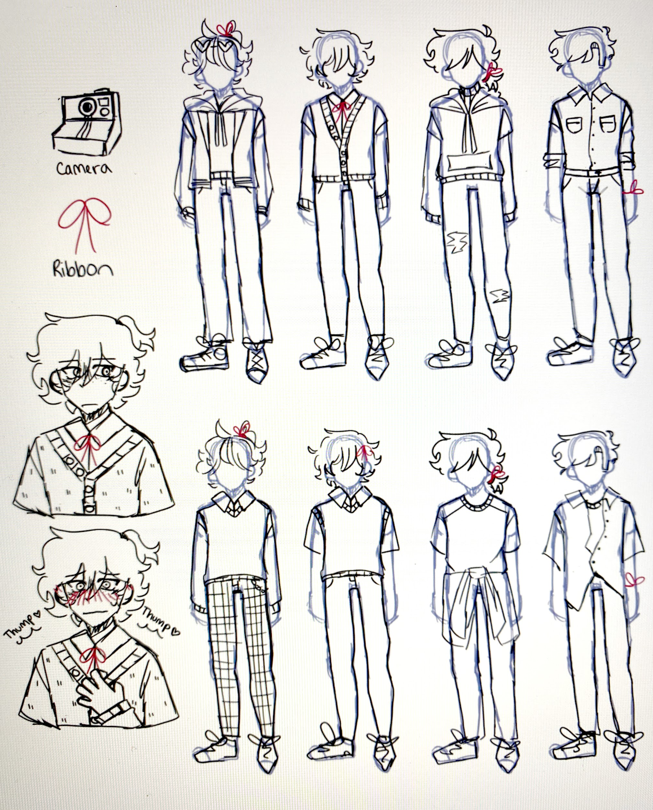
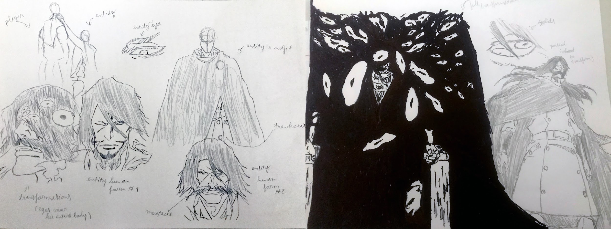
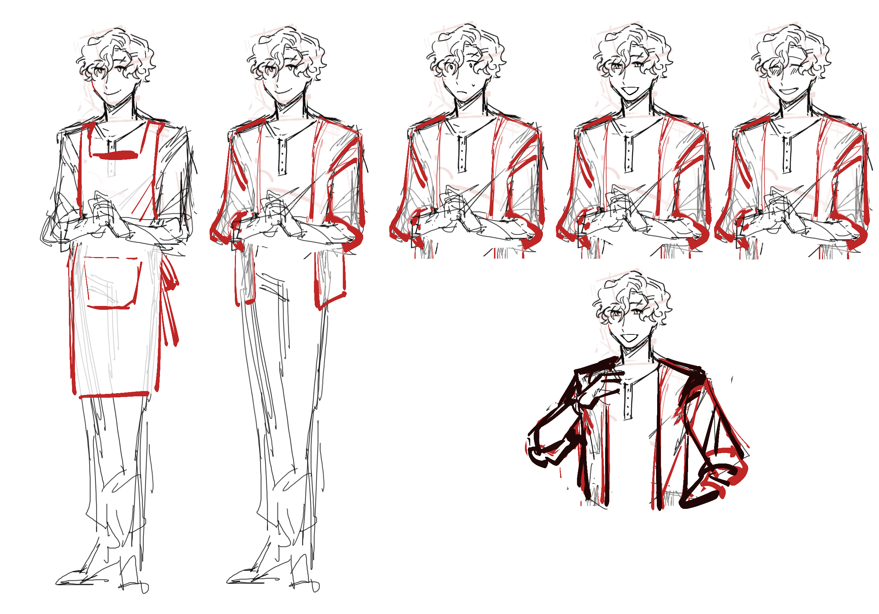
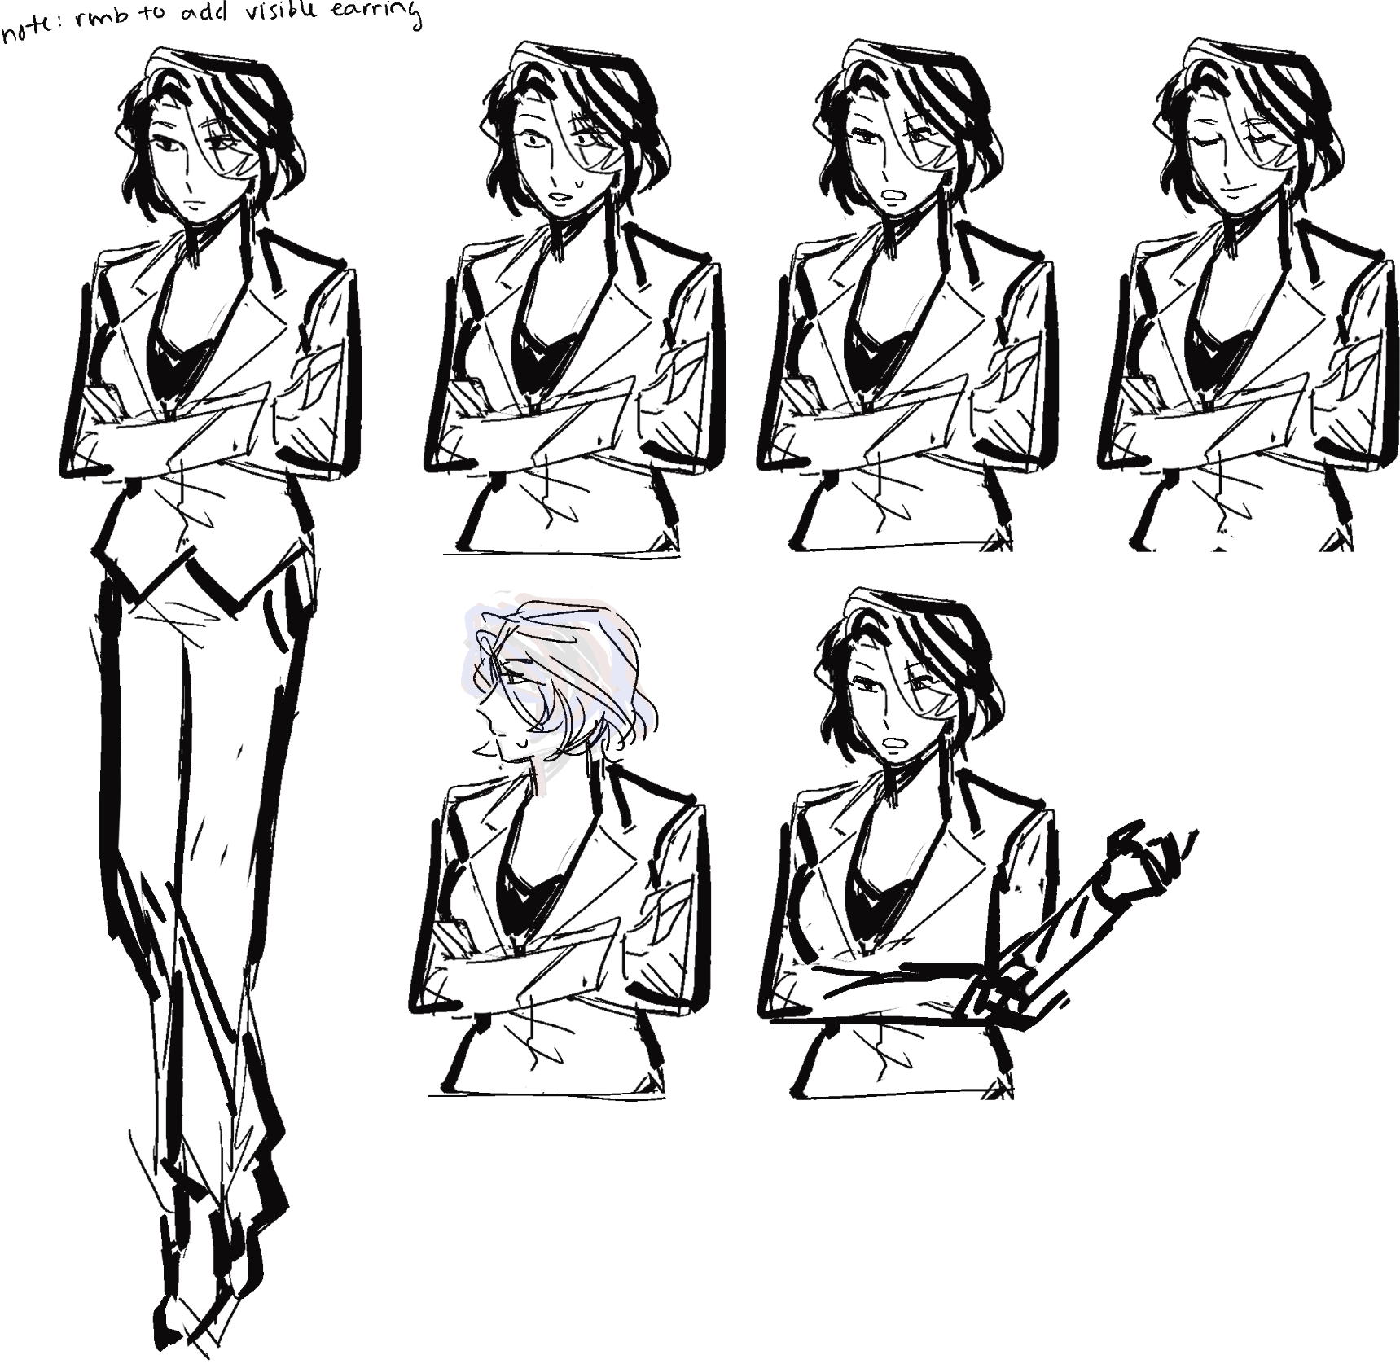
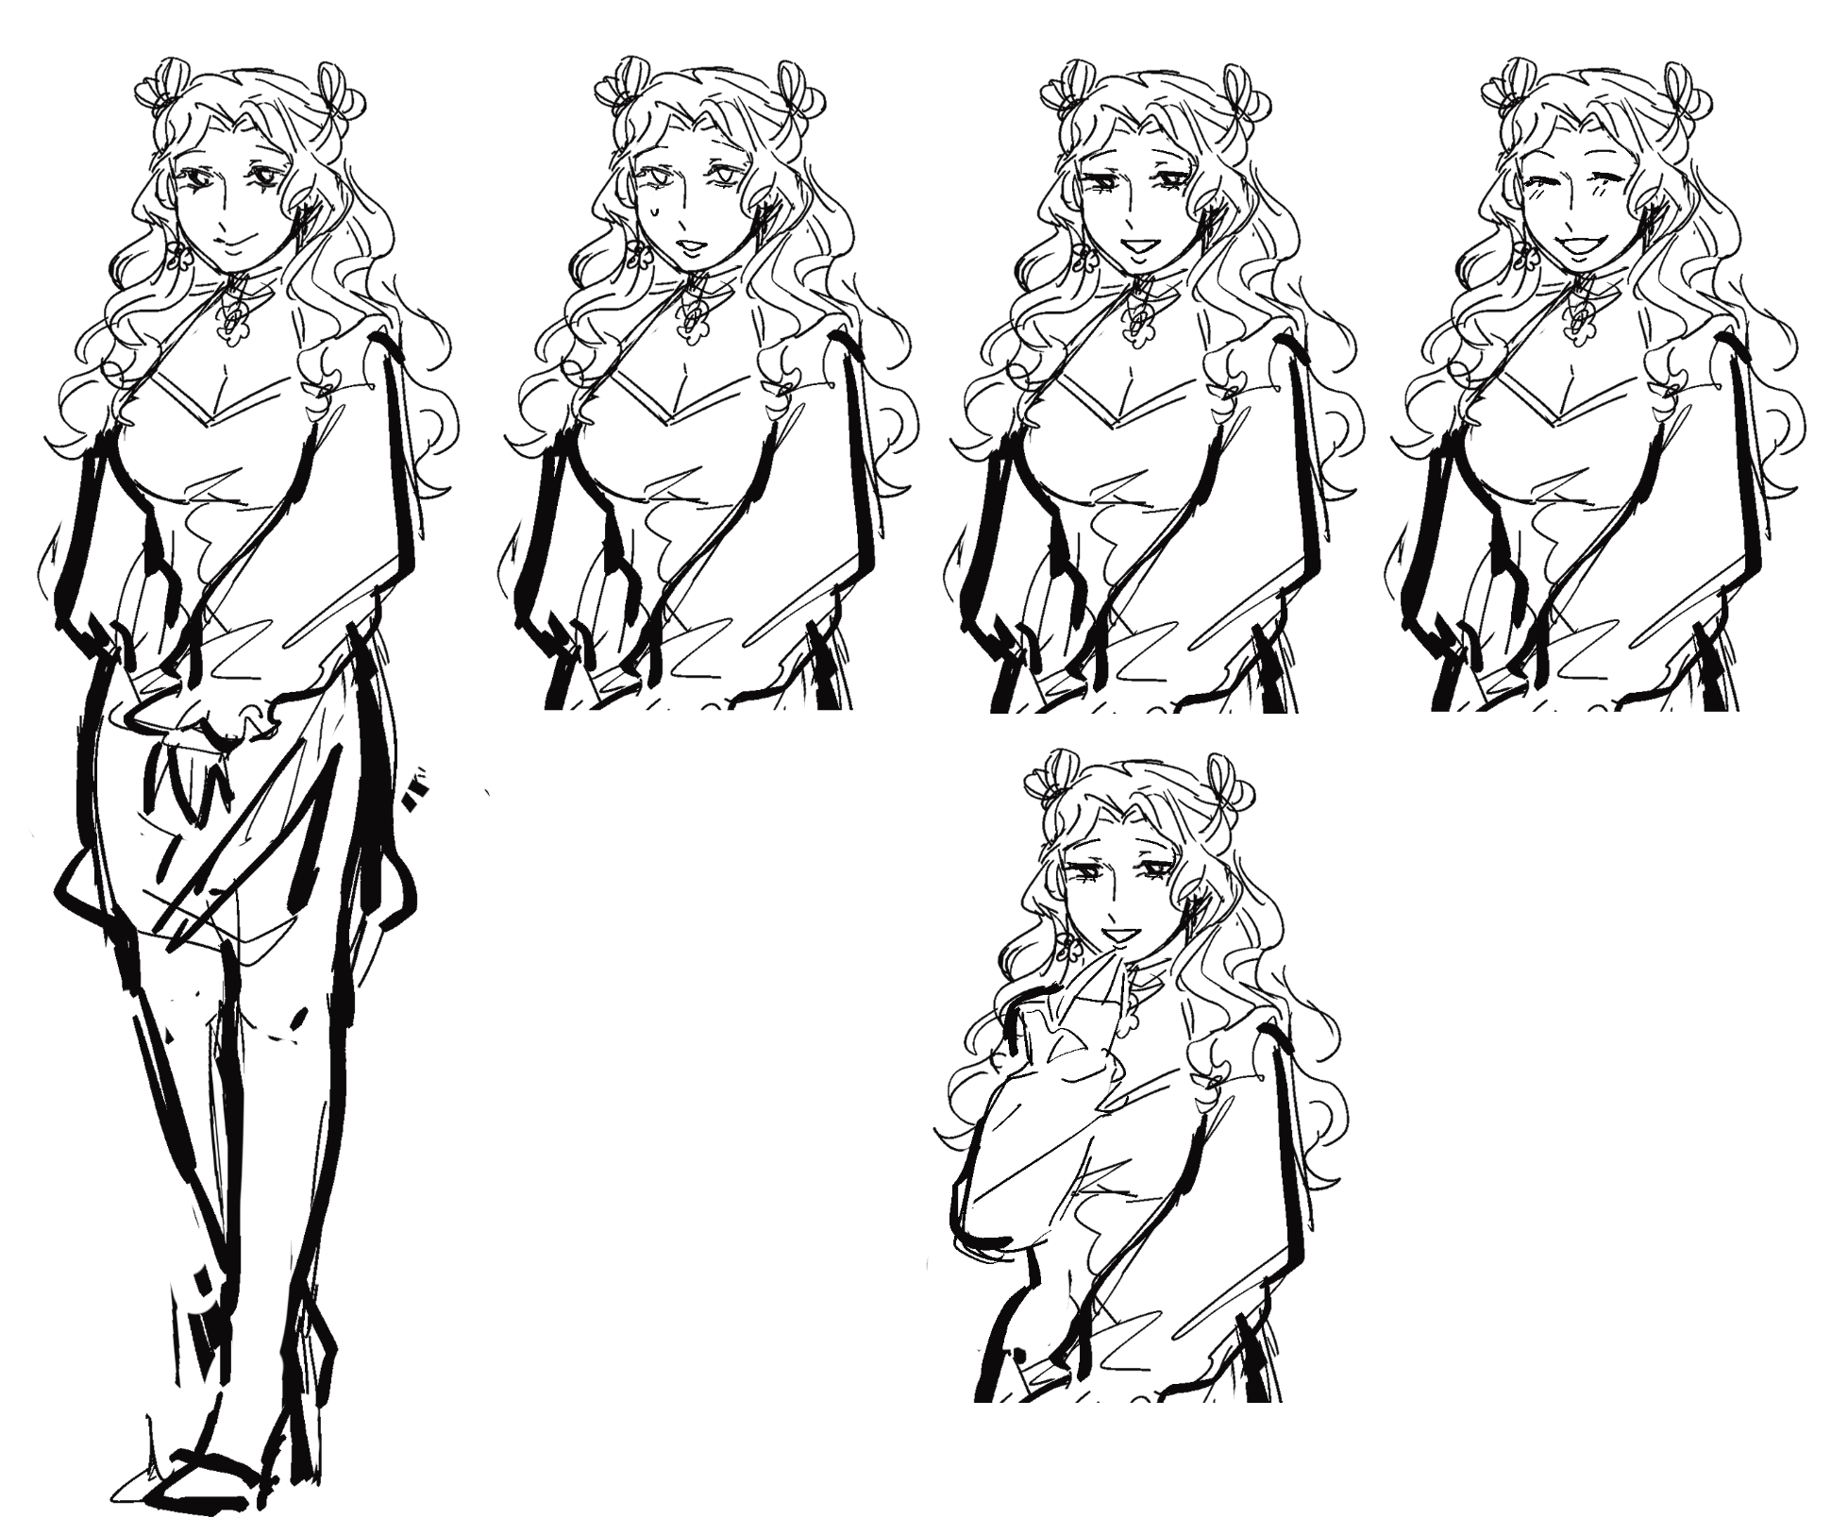
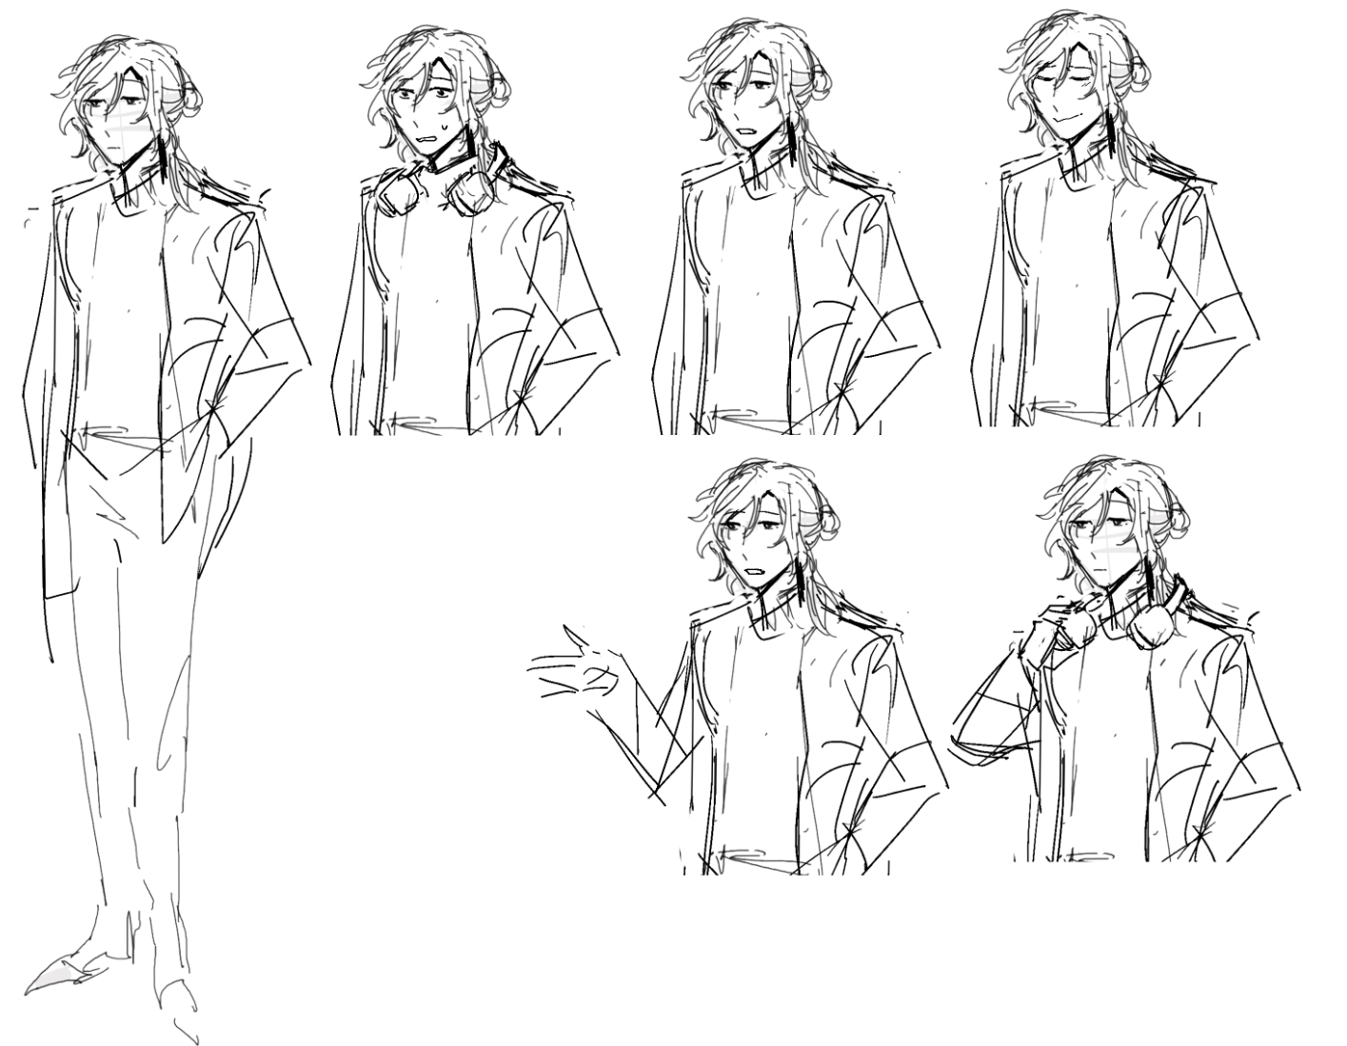
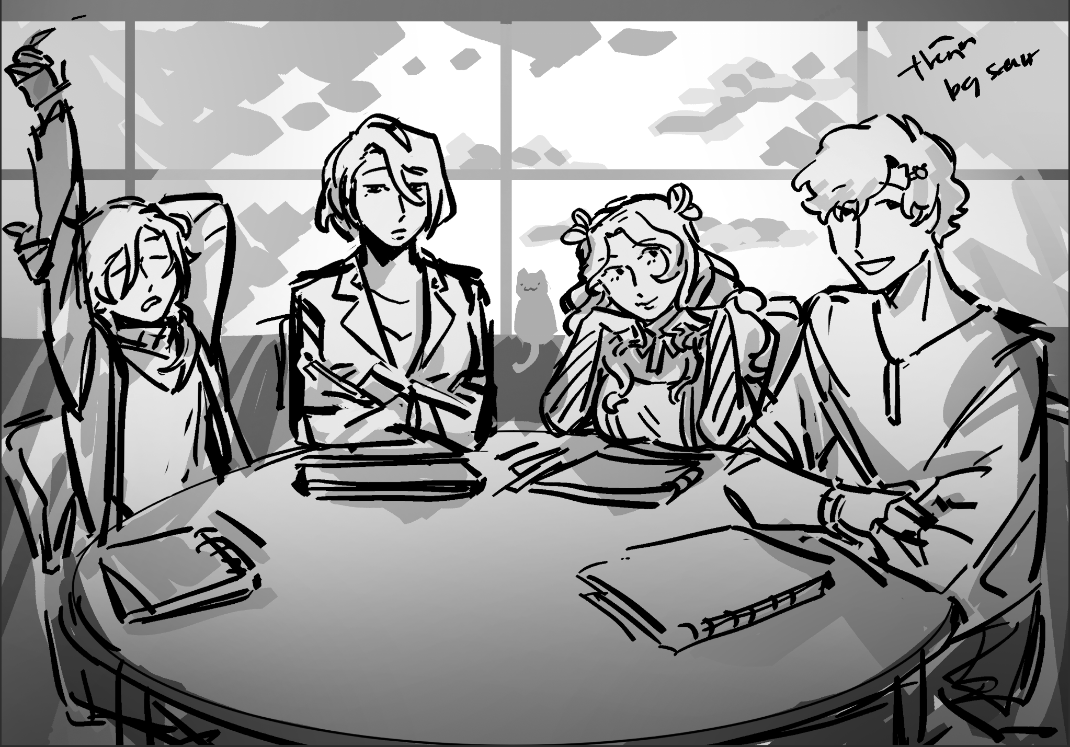
Character Development
Character Outline
Visual development & design
Thumbnails,turn arounds, expressions, pose sheets.

Slide 7
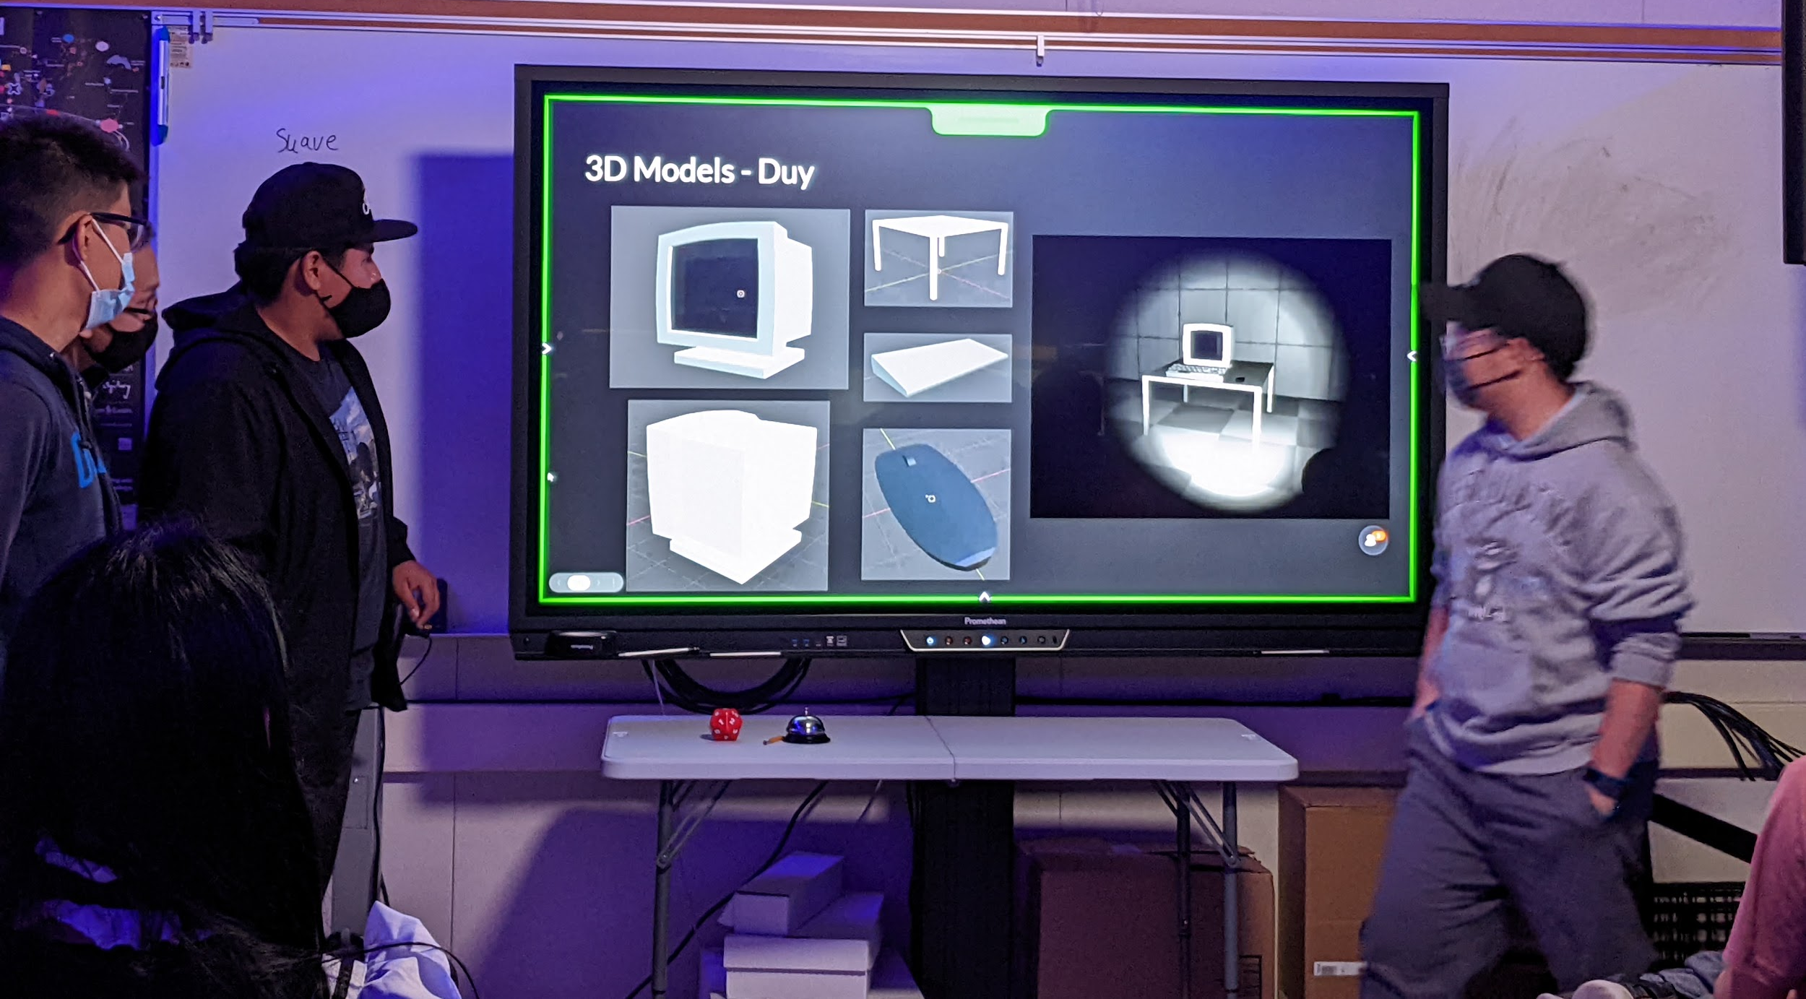
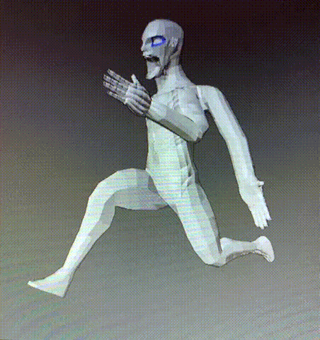
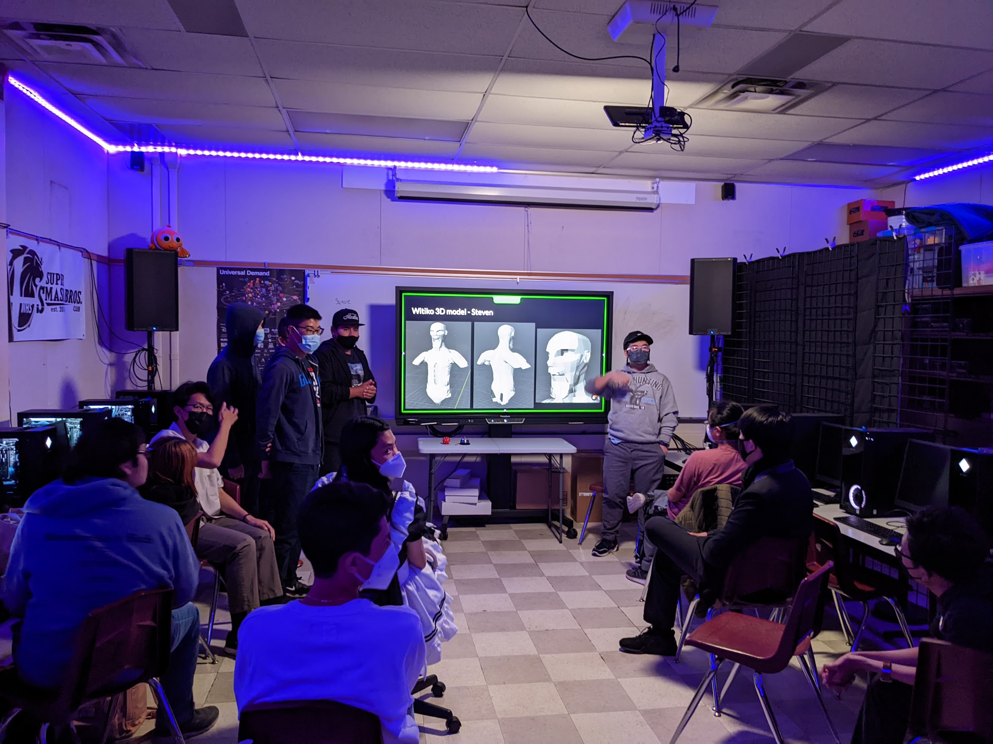
3D Modeling
Model our character in 3D. Using Blender.
Thinking in 3D is hard.
Topology
Texture + Shader

Slide 8
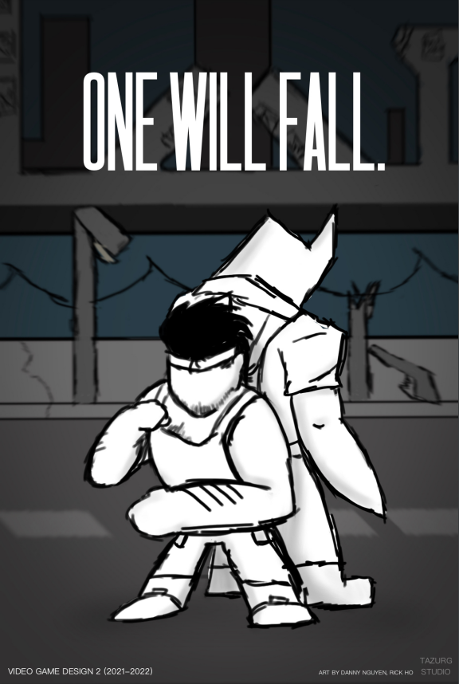
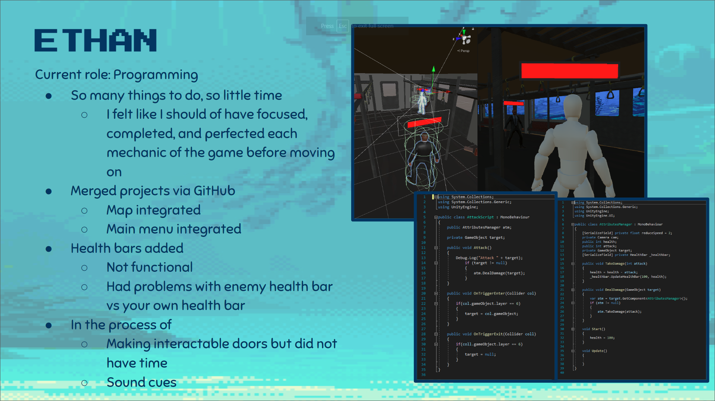
Portfolio
Demo reel
Website portfolio
Social media
Artist networks
Intellectual property

