Slide 1
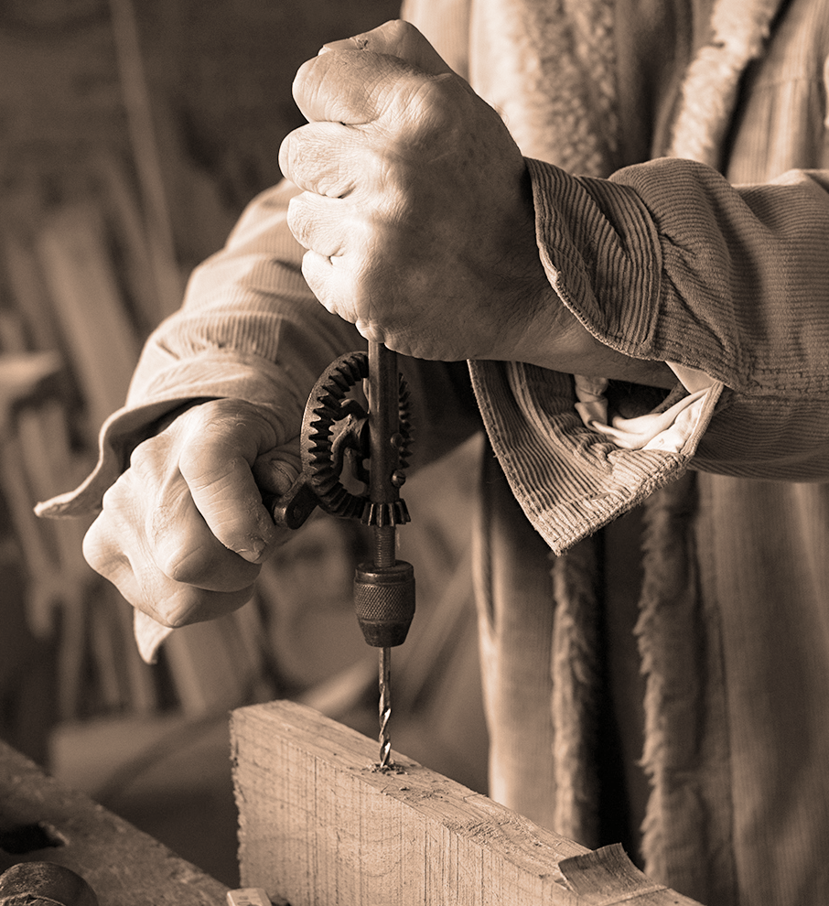
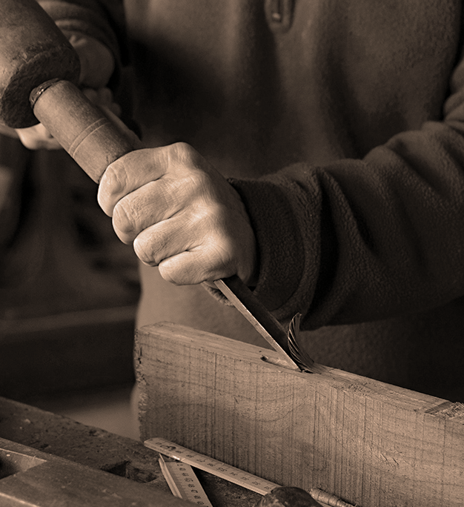
Woodworking: An Introduction
With Mr. Robinson

Slide 2
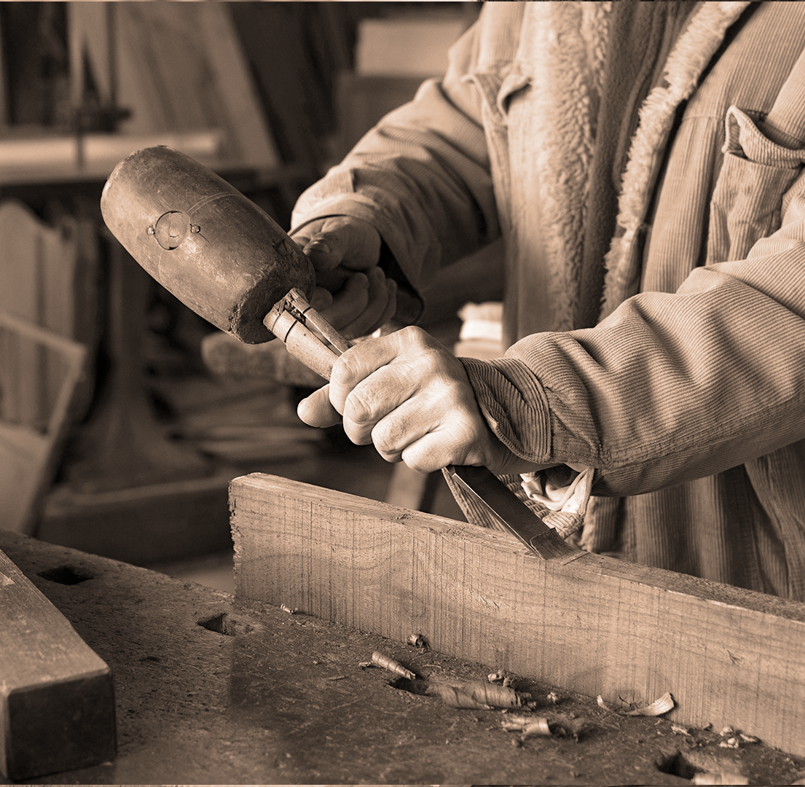
Mr. Robinson’s woodworking experience
I grew up a nephew of a construction worker and a cabinet maker. At the time, I felt I was just treated as an extra laborer, until I got a little older and came to realize that I had learned some very valuable skills that I would utilize for the rest of my life. Learning building codes and techniques helps a great deal when you own your own home, and need to fix or build something.
Working in the industry not only taught me woodworking skills, but teamwork skills and the value of hard work. Even at the end of the day when you are exhausted, the sense of accomplishment is enormous, when you see what you have completed that day, or week.

Slide 3
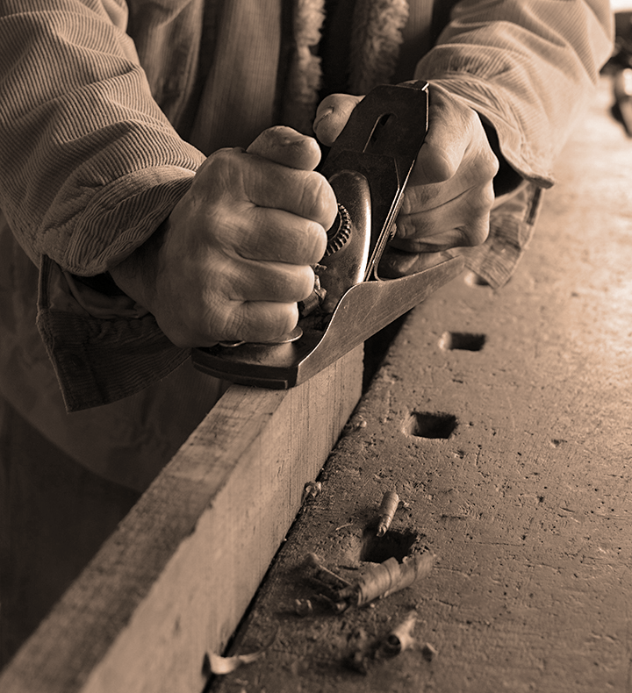
Industry overview
The construction industry is a very labor intensive occupation. One job you may be framing a new house or add on, the next job you are demolishing a bathroom or kitchen, in order to construct a new one. The best part is every job is different, and not repetitive.
Cabinet making is less physically demanding, but a lot more mental. Precision and patience are key to making products that are visually pleasing and don’t look thrown together. Most of your work will be in your workshop, not on site, so you don’t have to travel as much.

Slide 4
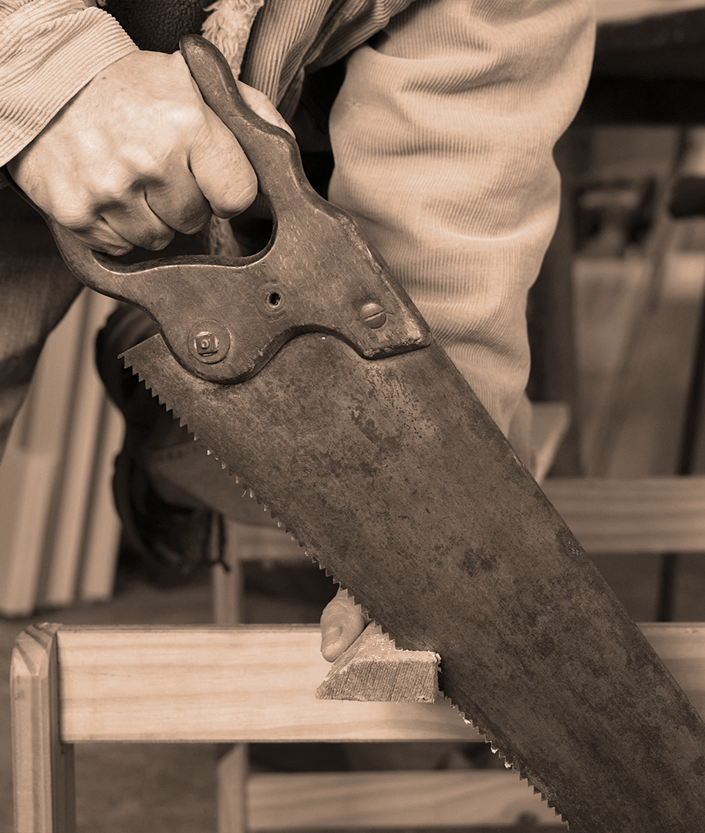
Teaching experience
I have been a high school teacher for 25 years. Teaching US History and US Government, was what drew me into the profession to start with. My first years I also coached football, which I really enjoyed, getting to know students on another level.
It's only been a couple of years ago that the opportunity to teach woodshop has come up, with a retirement. This new opportunity and challenged has invigorated and inspired me to show my students the relevance of these skills, regardless of what profession they choose in life. Life long skills for everyone is what I preach! I love it in this shop, it is my happy place!

Slide 5
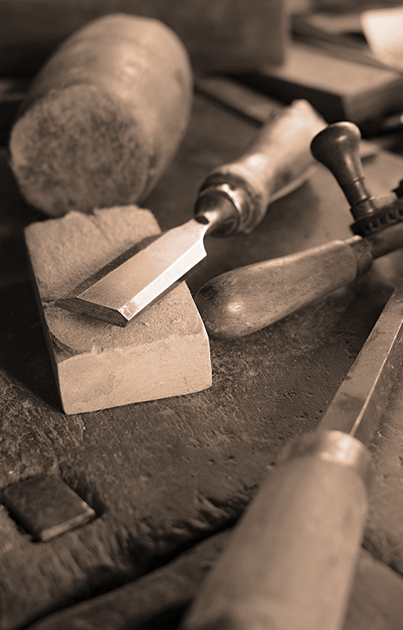
SKills
01
02
03
04
Wood joinery
Flattening wood
Wood carving
Wood finishing

Slide 6
Correct wood selection
Bark
Protects the live tree and wood from insects, animals, etc. Not used in our class
Wood selection
Growth rings
Different woods have different purposes and strengths, we will learn how to properly select a wood species for different projects..
Shows how old a tree is, and is where the usable lumber is obtained
Sapwood
The newest wood in a tree, not very stable or desirable.

Slide 7

Woods we work with
20%
25%
cEDAR
OAK
Most common for yard fence boards, can be used for construction projects and hobbyist
One of the most common for cabinets and furniture. Hard wood, only moderately priced
45%
10%
Pine wood
Black Walnut
Inexpensive and easily attainable, simple to work with.
Very expensive, but visually pleasing and really hard

Slide 8
Wood working tools
Chisels
Measure tools
Mars is actually a very cold place
Neptune is the farthest planet from the Sun
Carving knives
Gouges
Jupiter is the biggest planet of them all
Saturn is a gas giant and has several rings

Slide 9
What are you going to learn?
Carving techniques
Surface treatment
Finish techniques

Slide 10
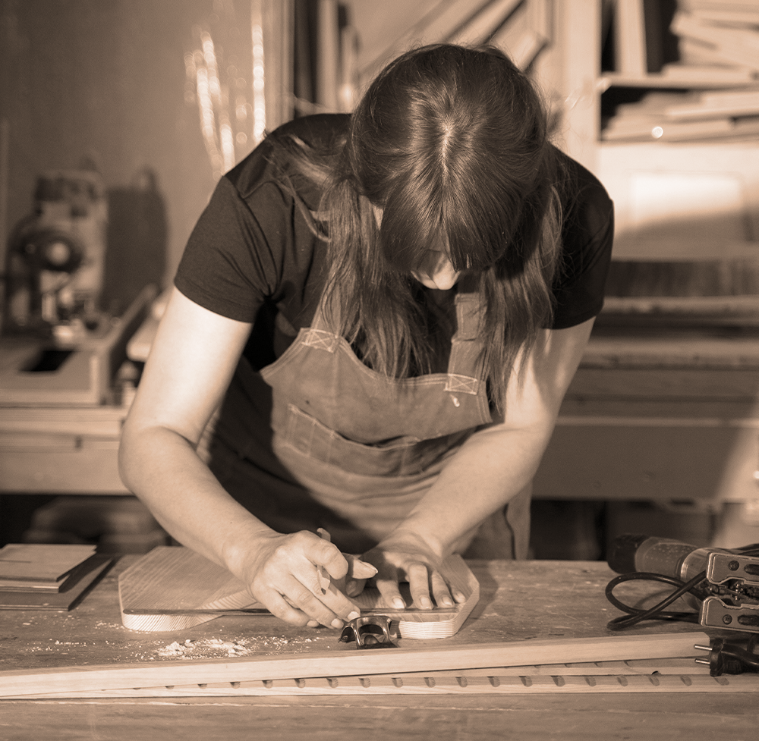
How will you use these skills
The skills learned in this class will directly relate to and help you get a job in the construction industry. Basic woodworking skills, wood joinery and shaping will be used at every construction site.
Knowledge of the most common wood joints, and current construction codes will help lead you to framing.
The wood carving and shaping we do in this class are the first skill necessary to beging contructing cabinets and other finish woodworking projects like molding and floorboards.

Slide 11
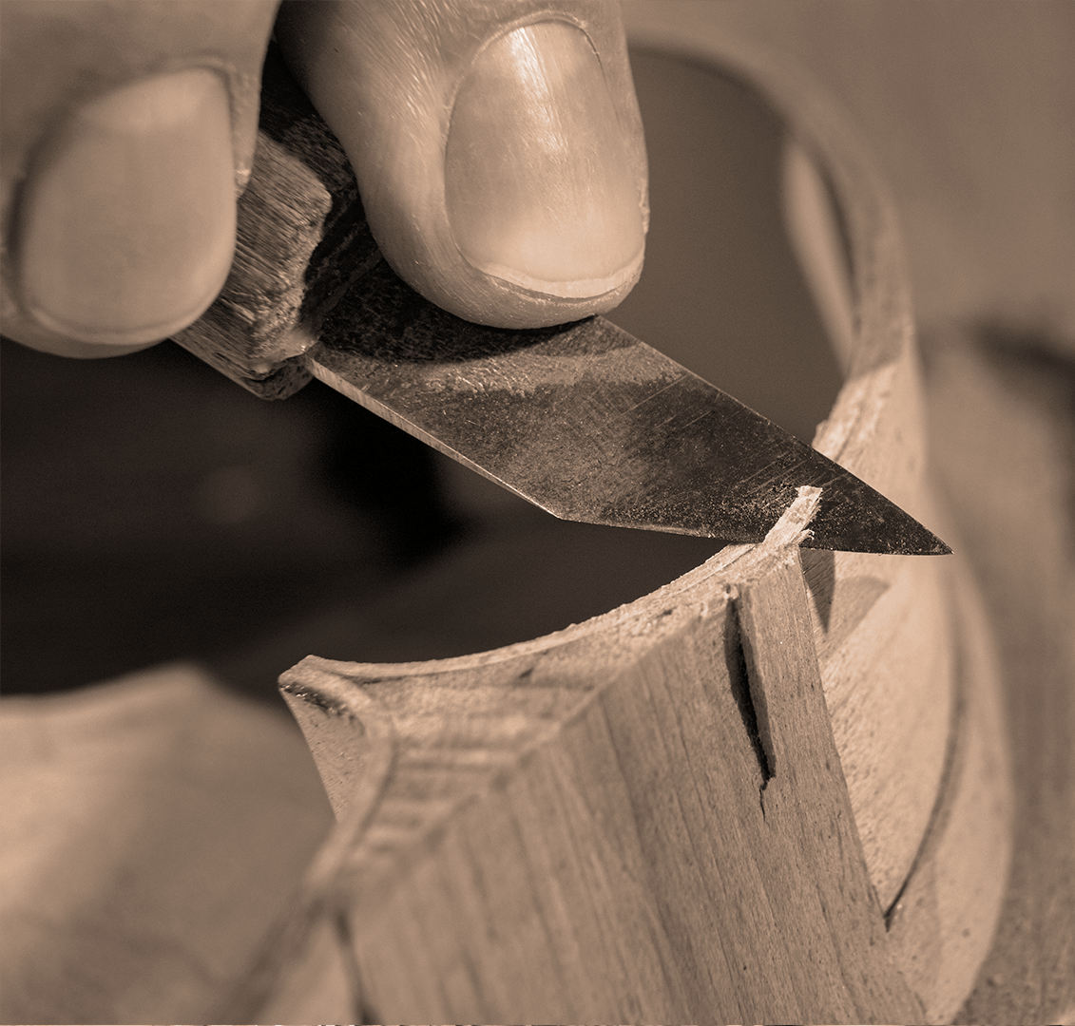
Type of work
Several options
Common entry point into the profession. Idea is start off at the bottom and work your way up as you learn more skills
General construction
Knowledge of advanced wood joinery and construction codes are needed.
framing
Highest level of skill, usually requires some previous construction experience
Cabinet making

Slide 12
Average earnings
General | framing | Cabinets | DIY
Entry into the profession. Construction laborers and helpers perform many tasks that require physical labor on construction sites. High school diploma $37,520 Growing at a rate of 4%, which is average | Carpenters construct, repair, and install building frameworks and structures made from wood and other materials. High school diploma $48,260 2% growth, slower than average. | Cabinetry requires advanced woodworking skills, CAD designing and VCarve CNC operating. 25% require post-HS certificate. Without these skills, the job outlook is negative, as they are all moving toward computer aided design. $100,000 | Priceless! The amount of money you will save over a lifetime, not having to hire somebody to do these things around your house is crazy!

