Slide 1
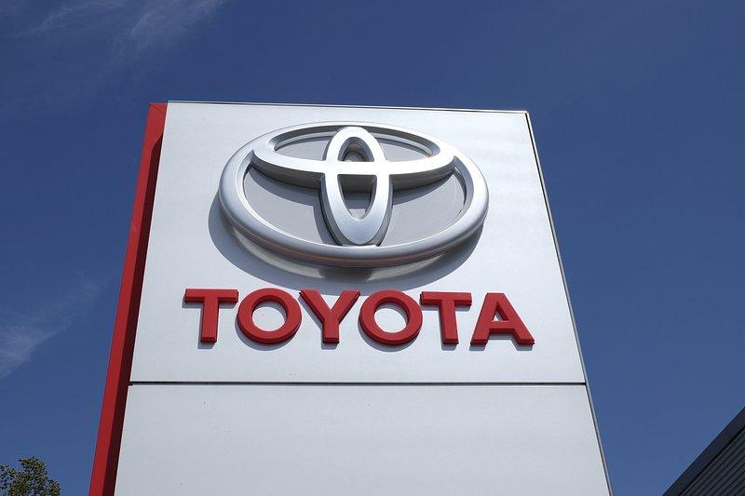
What you can learn in Automotive Technology!
Focused on safety first!
Toyota TECS first year learn the Toyota brand and earn Toyota certifications as well as enhanced maintenance and repair skills
Second year classes build on first year knowledge to learn advanced repair and diagnostic skills
First year classes learn about careers, auto maintenance (oil changes and multipoint inspections) and general repair (brakes, belts, filters,electrical).
Second year Toyota TECS learn Toyota specific diagnostics and Toyota technology plus more certifications
Toyota Certifications stay on students Toyota file and can be used to help get a job with Toyota

