Slide 1
Cabinetry, Millwork, and Woodworking
Building and Construction Trades

Slide 2
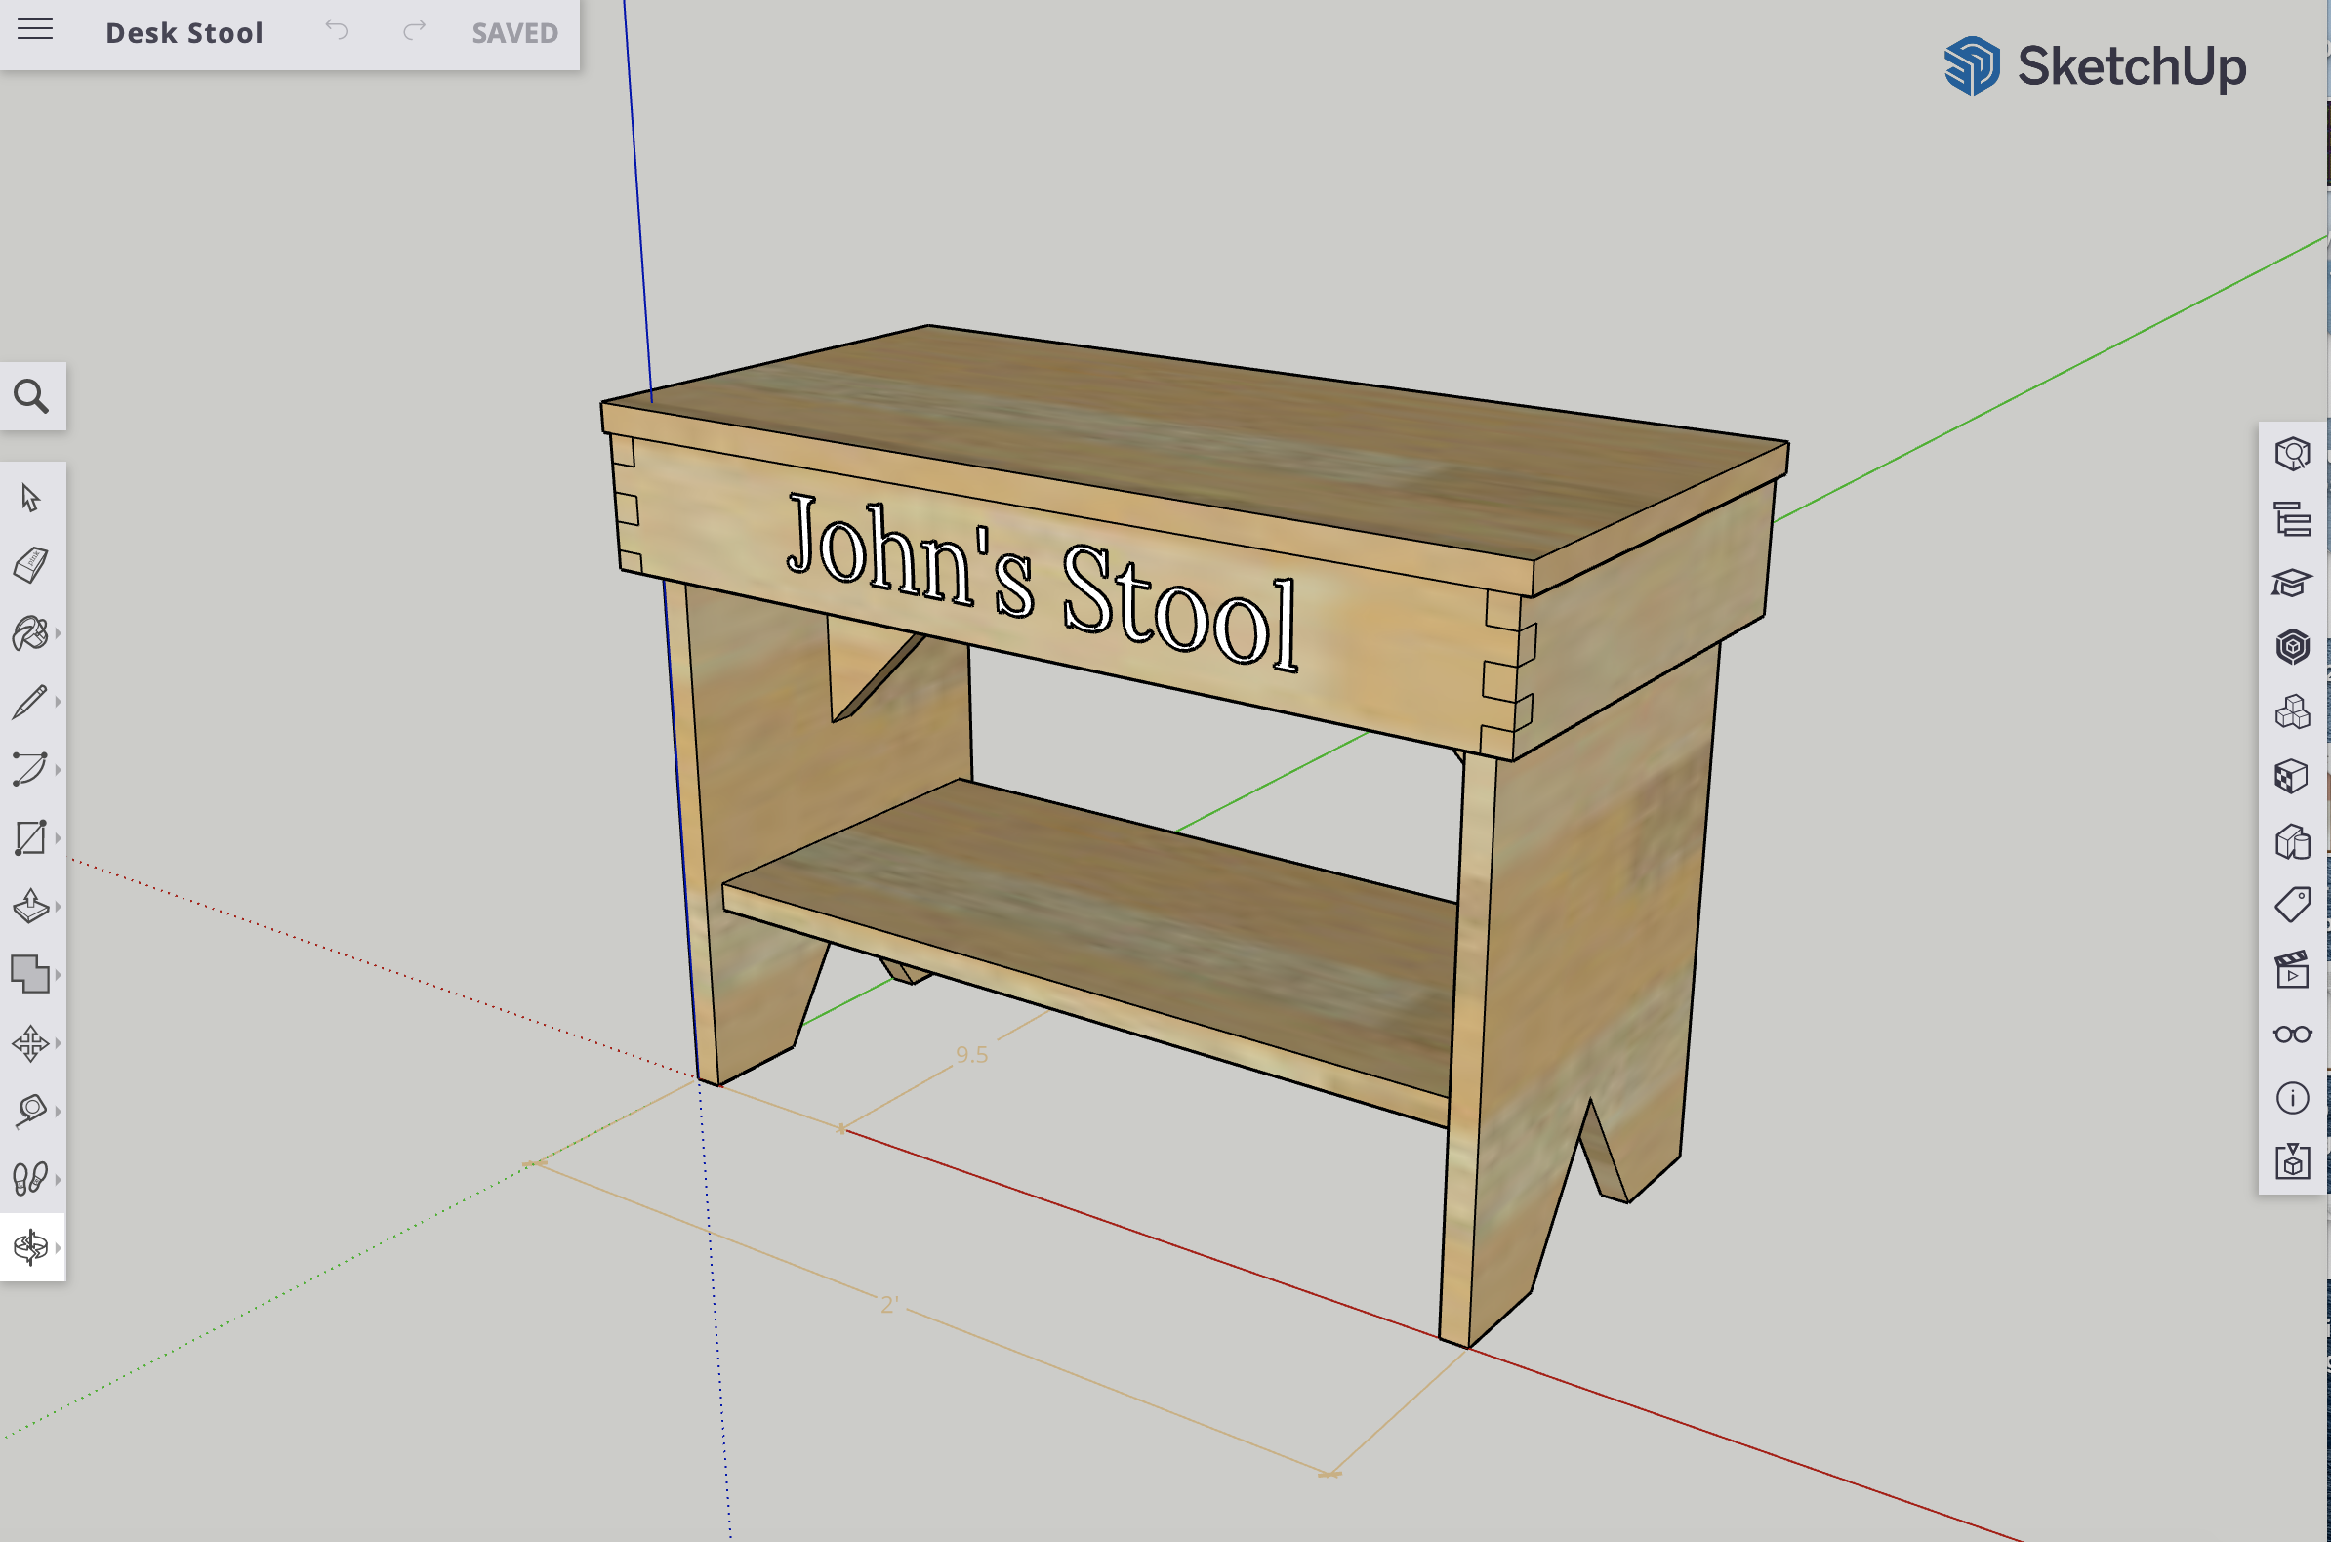
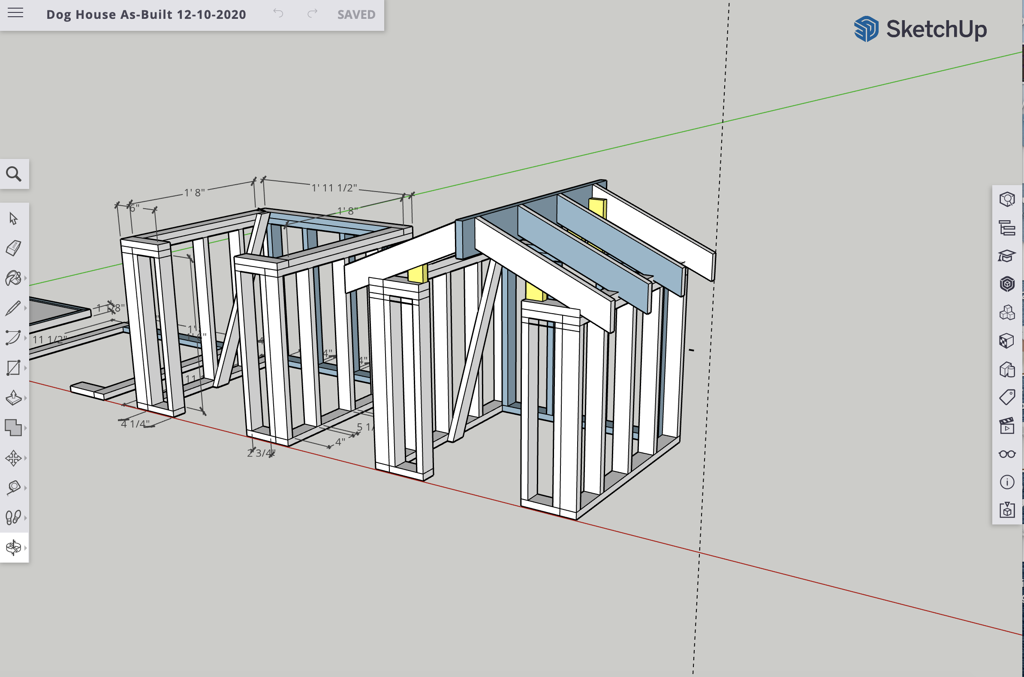
Design and Fabrication
Students in this pathway will build the experience and skills needed to bring a product concept to life beginning with both hand and computer-generated drawing skills.
Our program offers students the access to prototype what they intend to build by starting with 3D-printed models. Students use these models to guide their own manufacturing quality control.

Slide 3
Guided Hands-on Instruction
All students will engage in fabricating instructional projects as well as personal projects which they design on their own. As students progress through this pathway, they will build functional samples of:
Butcher blocks
Stools
Cabinets
Shelves
Jewelry Boxes
End Tables
Clocks
Lamps
Night Stands
Shaping and Fitting Tools
Plaques
And more!

Slide 4
Course Sequence
Cabinetry, Millwork, and Woodworking is the Career & Technical Education pathway we offer within the Building and Construction Trades industry sector. Students who complete the sequence with a “B” average are recognized at graduation and are rewarded an honor cord.
Both courses are UC “G” College Preparatory Electives!
Advanced Woodworking
Principles of Woodworking

Slide 5
Performance-Based Grades
3 - Student demonstrates mastery of the aligned pathway or foundation standard
2 - Student demonstrates inconsistent mastery or only partial mastery of the aligned pathway or foundation standard
1 - Student does not demonstrate mastery, or has failed to address the objectives of the task/assignment/activity
0 - Student has not submitted evidence of mastery
What matters most? Earning a “point” or demonstrating mastery?
Translation?
GRADE | RANGE HI | RANGE LOW
A | 100 | 79.5
B | 79.4 | 59.5
C | 59.4 | 39.5
D | 39.4 | 19.5
F | 19.4 | 0
EFFORT has VALUE!

Slide 6
gberger@hbuhsd.edu
714-893-1381, extension 52174 AND 52175

